Slide 1

Nutrition & You
Fifth Edition
Chapter 8 Lecture
Minerals and Water
Copyright © 2020 Pearson Education, Inc. All Rights Reserved
Notes:
If this PowerPoint presentation contains mathematical equations, you may need to check that your computer has the following installed:
1) MathType Plugin
2) Math Player (free versions available)
3) NVDA Reader (free versions available)

Slide 2
Objectives for Chapter 8 (1 of 2)
8.1 Explain the importance and functions of water in the body.
8.2 Describe water balance and how the body maintains it.
8.3 Identify daily water needs and the best sources for it.
8.4 Explain what minerals are and why you need them.

Slide 3
Objectives for Chapter 8 (2 of 2)
8.5 Name the functions, sources, and deficiency/toxicity of:
  Sodium
  Potassium
  Calcium
  Phosphorus
  Magnesium
  Chloride
  Sulfur
  Iron
  Copper
  Zinc
  Selenium
  Fluoride
  Chromium
  Iodine
  Manganese
  Molybdenum

Slide 4
Why Is Water so Important? (1 of 2)
Water is the most abundant substance in body
  Average healthy adult is about 60 percent water
    Muscle tissue is 75 percent water, fat up to 20 percent
  Can survive only a few days without water
  Water is balanced among fluid compartments
    Intracellular fluids: inside cells
    Extracellular fluids: interstitial fluid between cells and fluid in the blood
  Electrolytes: minerals that help maintain fluid balance

Slide 5
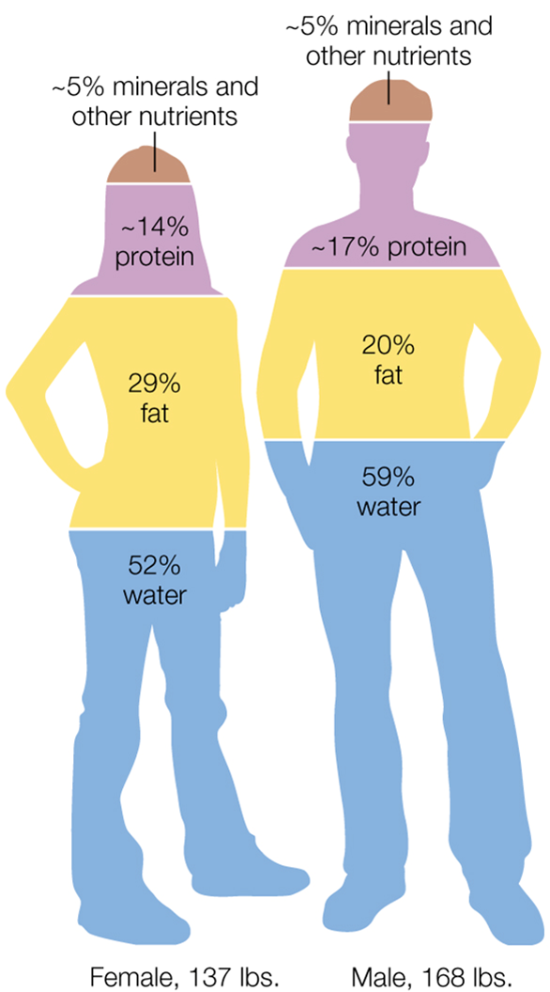
Figure 8.1 Your Body is Mostly Water

Slide 6
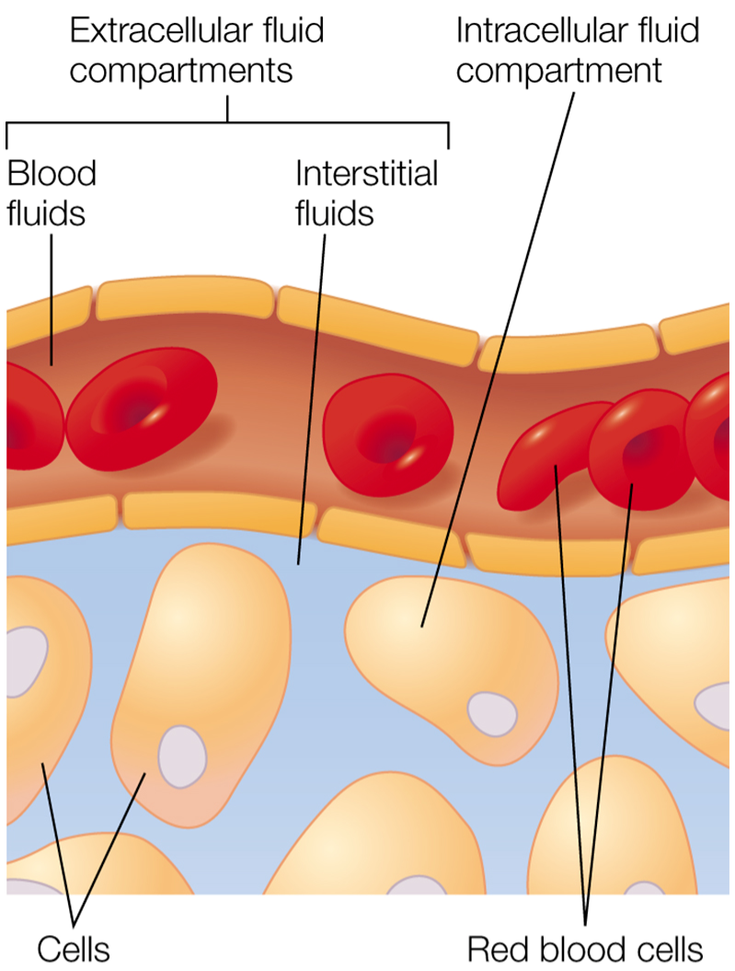
Figure 8.2 Water as Part of Body Fluids

Slide 7
Why Is Water so Important? (2 of 2)
Acts as universal solvent and transport medium
  Medium for chemical reactions in body
  As part of blood, helps transport oxygen, nutrients, hormones to cells
  As part of interstitial fluid, helps transport waste products away from cells for excretion
Helps maintain body temperature
Lubricant for joints, eyes; part of mucus and saliva
Protective cushion for brain, organs, fetus

Slide 8
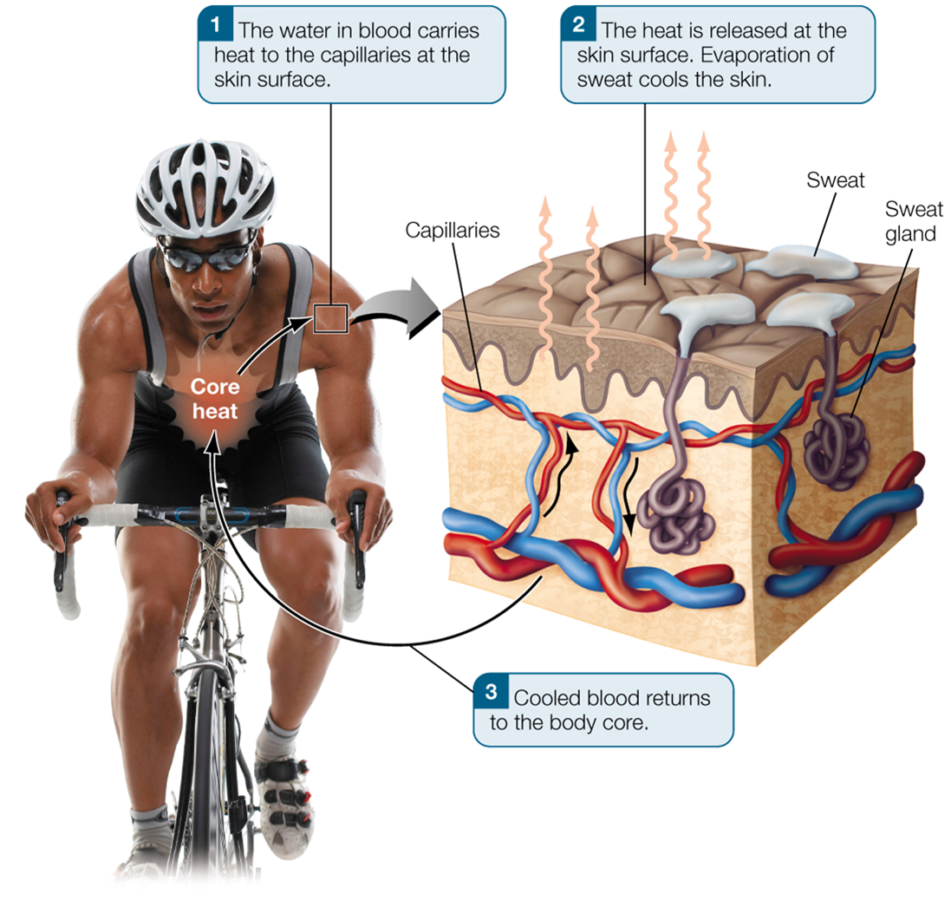
Figure 8.3 Water Helps Regulate Your Body Temperature

Slide 9
What Is Water Balance and How Do You Maintain It?
Water balance: water consumed = water lost
You take in water through beverages and food
You lose water through your kidneys (as urine), large intestine, lungs, skin
  Insensible water loss: through evaporation from skin and when you exhale
  Sensible water loss: through urine, feces, and sweat

Slide 10
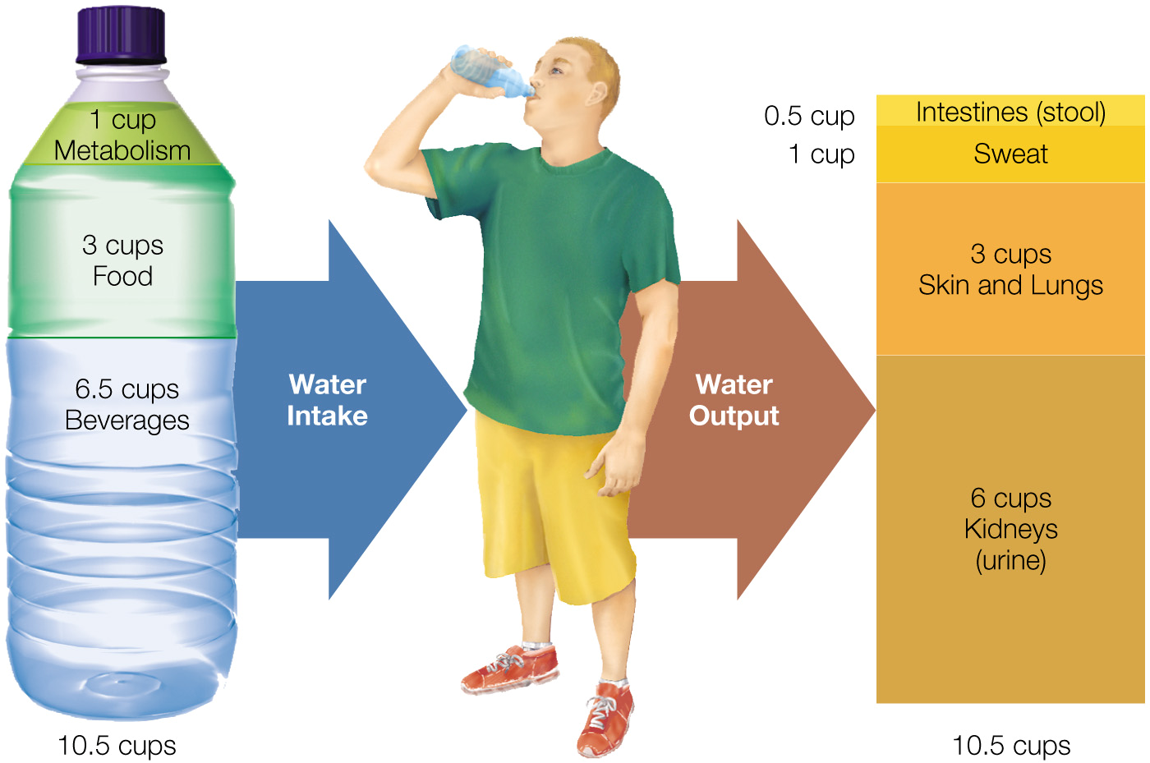
Figure 8.4 The Concept of Water Balance: Intake Equals Output

Slide 11
Losing Too Much Water Can Cause Dehydration (1 of 2)
Dehydration can result from inadequate water intake or too much water loss from diarrhea, vomiting, high fever, or use of diuretics
Your thirst mechanism signals dehydration
  Dry mouth due to increased electrolyte concentration in blood: less water available to make saliva
  Blood volume decreases, sodium concentration increases in blood
    Brain triggers thirst mechanism and secretion of antidiuretic hormone (A D H) to reduce urine output
    Fluid inside cells moves into blood by osmosis

Slide 12
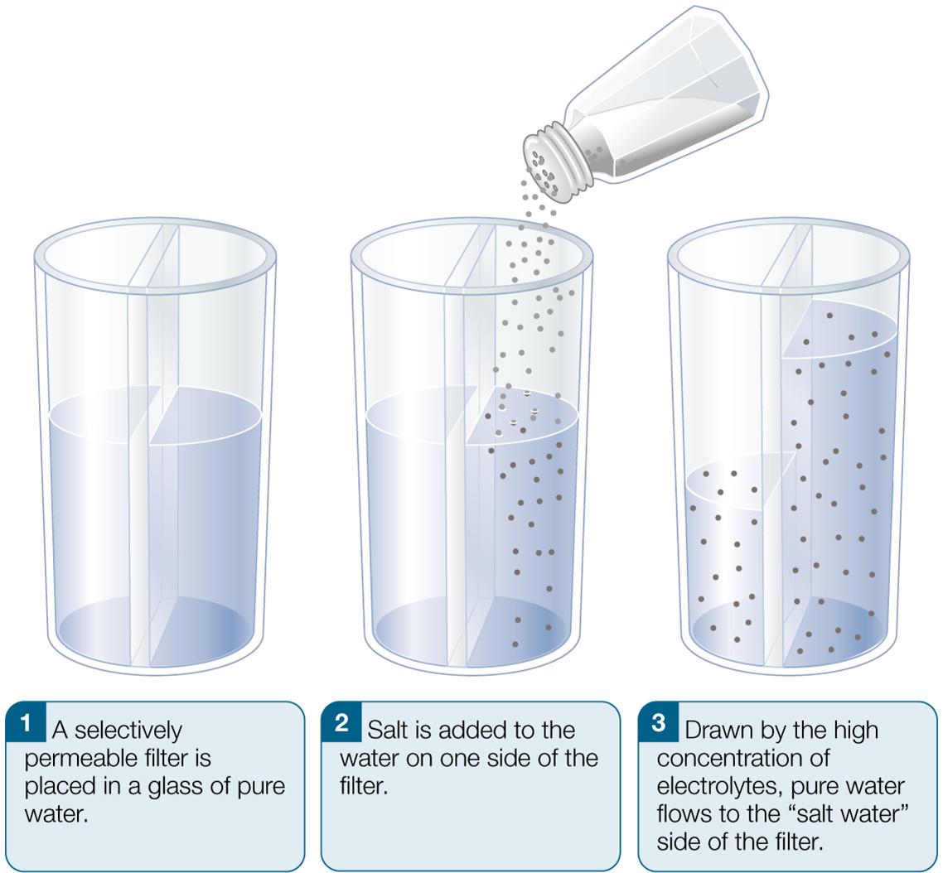
Figure 8.5 A Simple Demonstration of Osmosis

Slide 13
Losing Too Much Water Can Cause Dehydration (2 of 2)
Other ways to tell if you're dehydrated:
  Cornerstone method: measure body weight before and after exercise
    Weight loss = water loss
  Monitor urine color
    Color darkens with concentration, indicating water loss

Slide 14
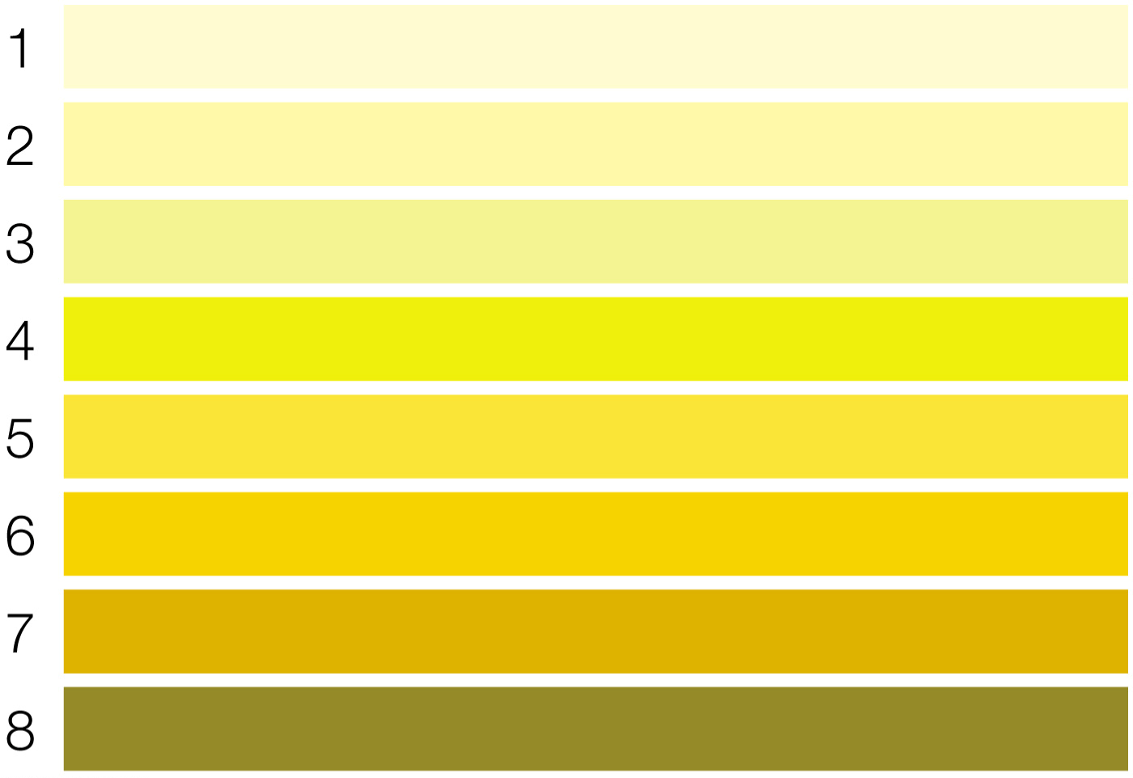
Figure 8.6 Urine Color Can Signal Dehydration

Slide 15
Consuming Too Much Water Can Cause Hyponatremia
Hyponatremia is a condition of too little sodium in the blood
For healthy individuals who consume a balanced diet, it is difficult to consume too much water
However, some individuals have experienced water toxicity
  Examples: soldiers in training, endurance athletes

Slide 16
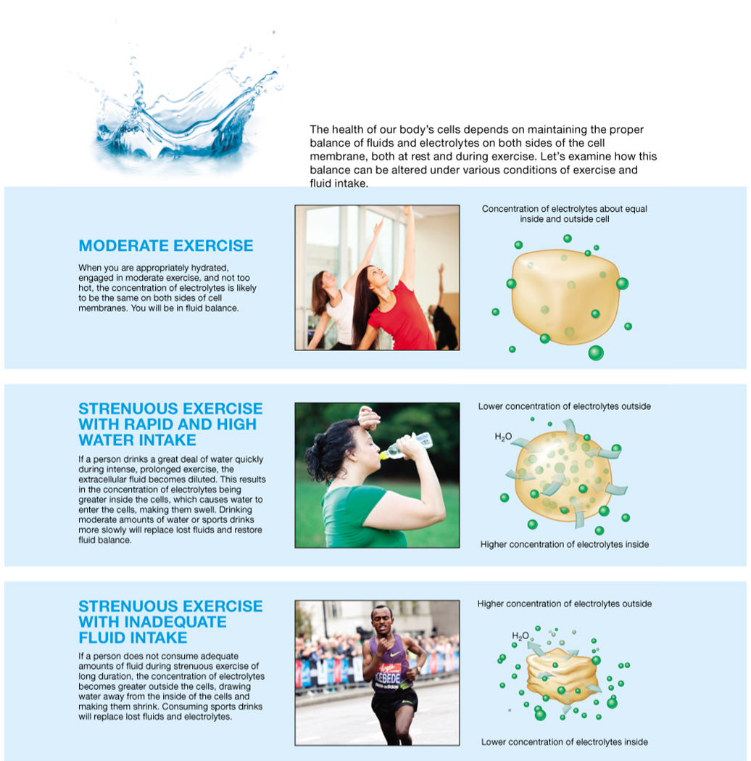
Figure 8.7 Fluid Balance During Exercise

Slide 17
How Much Water Do You Need and What Are the Best Sources?
Daily water needs depend on physical activity, environmental factors, diet
Recommendations based on reported total water intake of healthy Americans
Men: 16 cups/day (about 13 cups of beverages)
Women: 12 cups/day (about 9 cups of beverages)
  About 80 percent from beverages, 20 percent from foods
  Physical activity increases needs

Slide 18
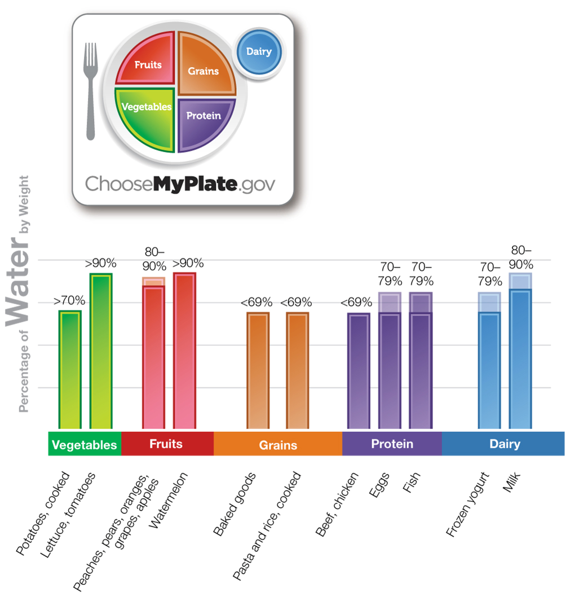
Figure 8.8 Water Content of Foods

Slide 19
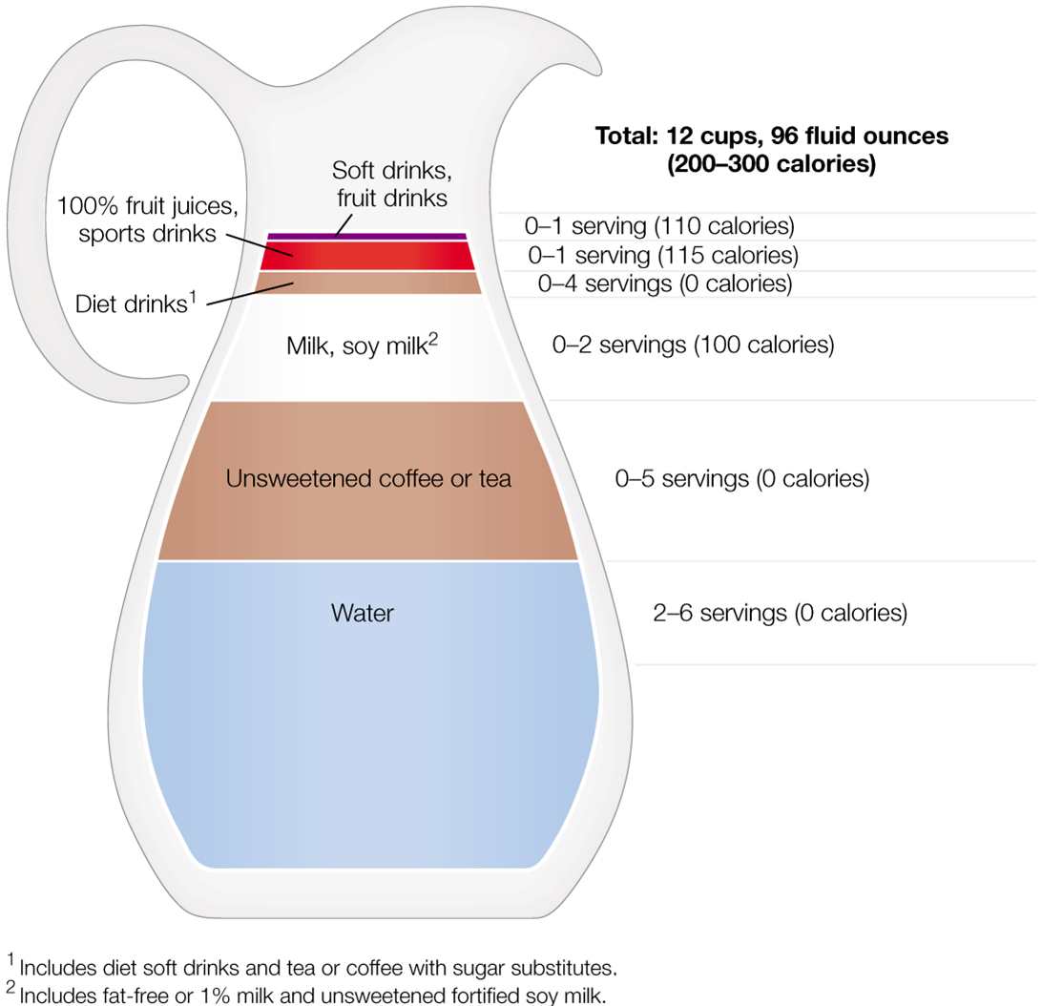
Figure 8.9 The Best Way to Meet Your Daily Water Needs

Slide 20
Nutrition in the Real World: Tap Water or Bottled Water: Is Bottled Better?
False assumption: bottled water is purer than tap water
Tap water is perfectly safe
  Monitored by Environmental Protection Agency (E P A)
  Provides fluoride, helps prevent dental caries
Bottled water is very popular
  Most products conform to F D A requirements
  May actually be tap water
  High cost
  Various "designer" waters on the market

Slide 21

Misc Table 8.1 A Well of Sources for Bottled Water
Mineral water | Water derived from an underground source that contains a specific amount of naturally occurring minerals and trace elements. The minerals and elements cannot be added to the water after bottling.
Spring water | Water that is obtained from underground water that flows naturally to the surface. The water is collected at the spring or at the site of the well purposefully drilled to obtain this water.
Sparkling water | Spring water that has carbon dioxide gas added to supply “bubbles” before bottling. Also sold as seltzer water or club soda. Note: This is technically considered a soft drink and does not have to adhere to F D A bottled water regulations.
Distilled water | Water that has been boiled and processed to remove most, but not all, contaminants.
Flavored water | Water that has a flavor such as lemon or lime added. It may also contain added sugars and calories.
Vitamin or enhanced waters | Water that has vitamins, protein, herbs, and/or caffeine added to it. Such water may also contain added sugars and calories.
Water can be classified according to its source or how it is treated prior to bottling.

Slide 22
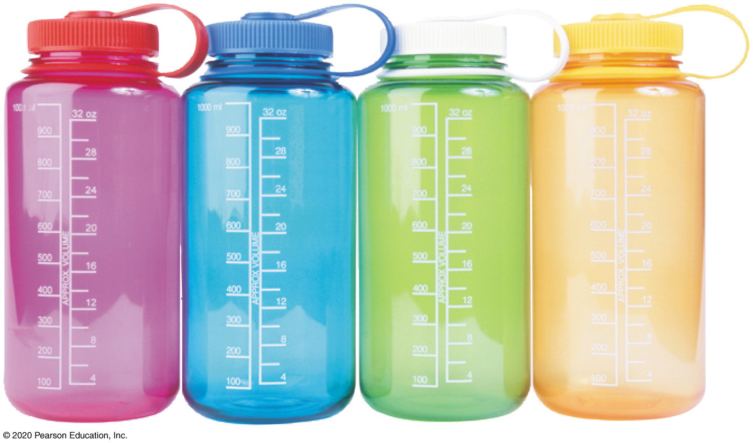
Misc Table 8.2 Bottled versus Tap Water: A Summary
Bottled Water | Tap Water
Cost to Consumers | Cost to Consumers
About $1.00–$4.00 per gallon (plain water) | About $0.003 per gallon
Designer waters can cost more than $10 per gallon and may contain added sugar and calories | Blank
Safety and Sustainability | Safety and Sustainability
Generally safe | Municipal water is regulated by E P A, state, and local regulations
Regulated by the F D A | EPA guidelines require that the public have access to water quality reports and be notified if water quality is outside established bounds
May not contain fluoride | Blank
If not recycled, end up as garbage in landfills | Blank
Benefits to Consumers | Benefits to Consumers
Packaging of bottled water may make it more convenient than tap water | Available at the faucet
Blank | Often contains fluoride, which helps to prevent tooth decay
May taste better than tap water | Doesn’t contain any added sugar or calories

Slide 23
What Are Minerals and Why Do You Need Them? (1 of 4)
Inorganic elements needed in relatively small amounts
Mineral absorption depends on bioavailability
  Some minerals compete for absorption: too much of one can decrease absorption of another
    Example: excess zinc can reduce copper absorption
  Some substances bind minerals, making them unavailable for absorption
    Example: oxalates in spinach bind calcium

Slide 24
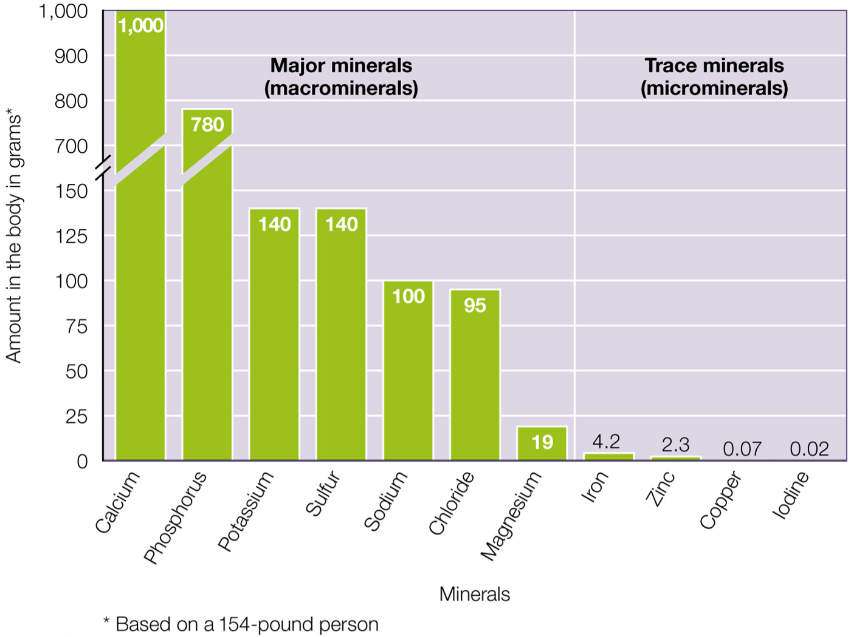
Figure 8.10 The Amounts of Different Minerals in Your Body

Slide 25
What Are Minerals and Why Do You Need Them? (2 of 4)
Major minerals (macrominerals): needed in amounts greater than 100 milligrams/day
Trace minerals (microminerals): needed in amounts less than 20 milligrams/day
You need major minerals in larger amounts
  Sodium, chloride, potassium, magnesium, sulfur play key roles in fluid balance
  Calcium, phosphorus, magnesium work together to strengthen bones and teeth

Slide 26
What Are Minerals and Why Do You Need Them? (3 of 4)
Trace minerals are needed in small amounts
  Play essential roles as important as major minerals
  Chromium and iodine help certain hormones
  Iron maintains healthy red blood cells
  Fluoride protects teeth
  Iron, zinc, copper, manganese, and molybdenum are cofactors that work with enzymes in critical chemical reactions

Slide 27
What Are Minerals and Why Do You Need Them? (4 of 4)
Overconsumption of minerals can be toxic
  Difference between recommended and excessive amount may be minimal
    Example: magnesium, which can cause gastrointestinal problems
Foods alone rarely provide excessive amounts
  Problems usually arise with supplements
  Another good reason to eat a varied diet

Slide 28
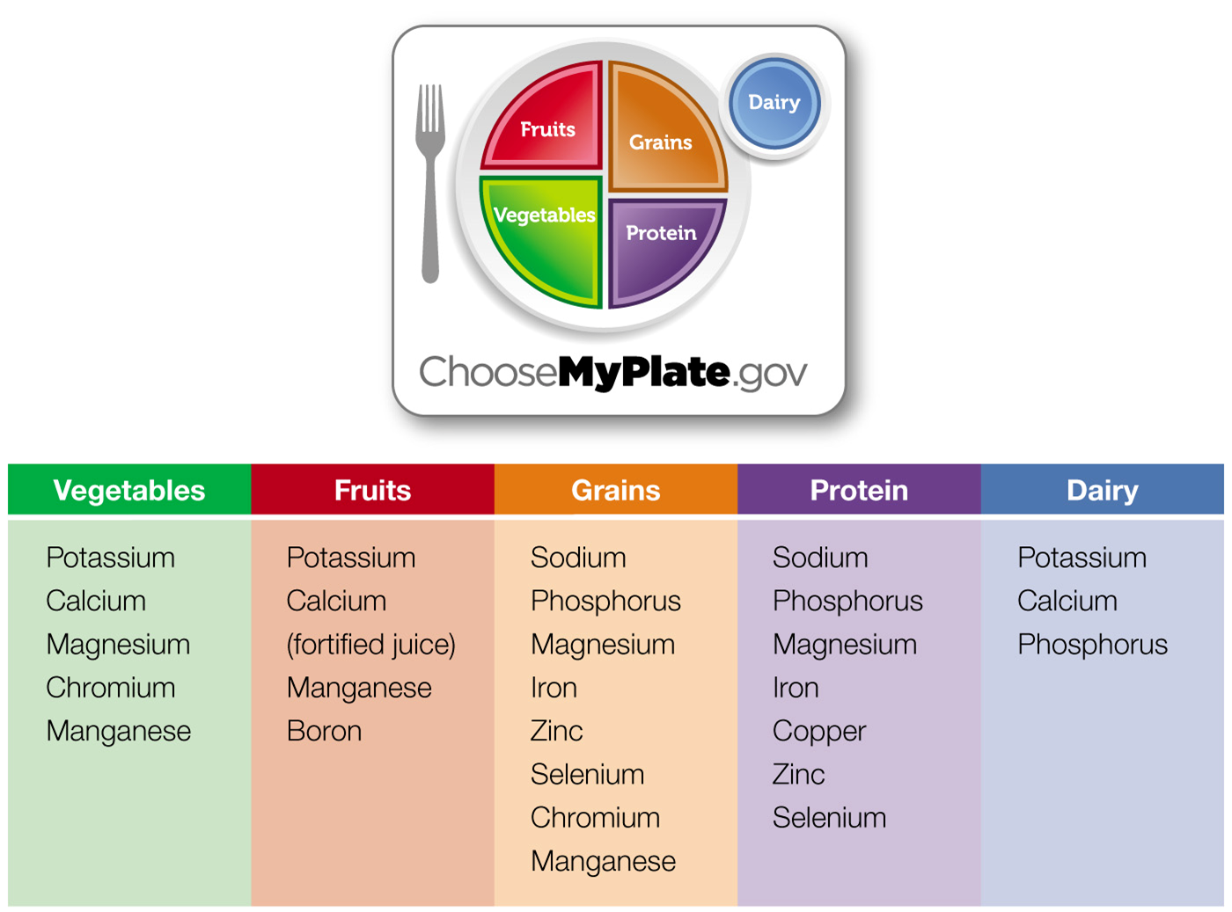
Figure 8.11 Minerals Are Found Widely in MyPlate

Slide 29
Table 8.1 Minerals at a Glance: Major Minerals (1 of 2)
Major Minerals | Major Functions | Adult D R I, 19 to 50 years | Food Sources | Excessive/ Toxicity Symptoms/U L | Deficiency Symptoms/ Conditions
Sodium | Major electrolyte outside the cell; helps regulate body water and blood pressure | 1,500 milligrams/day | Processed foods, table salt, meat, seafood, milk, cheese, eggs | Hypertension U L: 2,300 milligrams/day | Rare in individuals consuming a healthy diet
Potassium | Major mineral inside the cell, needed for muscle contraction and nerve impulses; regulates body water and blood pressure | 4,700 milligrams/day | Potatoes, melons, citrus fruits, most fruits and vegetables, meat, milk, legumes | Hyperkalemia | Hypokalemia
Calcium | Formation of bones and teeth, muscle contraction and relaxation, blood clotting, heart and nerve function | 1,000 milligrams/day | Milk and dairy products, leafy greens, broccoli, salmon, sardines, tofu | Hypercalcemia U L: 2,500 milligrams/day | Osteoporosis

Slide 30
Table 8.1 Minerals at a Glance: Major Minerals (2 of 2)
Major Minerals | Major Functions | Adult D R I, 19 to 50 years | Food Sources | Excessive/ Toxicity Symptoms/U L | Deficiency Symptoms/ Conditions
Phosphorus | Formation of bones and teeth | 700 milligrams/day | Meat, fish, poultry, eggs, dairy, cereals | Hyperphosphatemia U L: 4,000 milligrams/day | Muscle weakness, bone pain, rickets, confusion, and death
Magnesium | Participates in muscle contraction and nerve conduction | 310 to 420 milligrams/day | Meat, seafood, nuts, legumes, dairy, whole grains | Large intakes from supplements can cause diarrhea, cramps, and nausea | Rare
Chloride | Helps maintain fluid and acid-base balance | 2,300 milligrams/day | Found as sodium chloride in foods | U L: 3,600 milligrams/day | Rare
Sulfur | A part of other compounds in body; helps give some amino acids their three- dimensional shape | None | Meats, fish, poultry, eggs, dairy foods, fruits, vegetables | None | None

Slide 31
Table 8.2 Minerals at a Glance: Trace Minerals (1 of 3)
Trace Minerals | Major Functions | Adult DRI, 19 to 50 years | Food Sources | Excessive/ Toxicity Symptoms/U L | Deficiency Symptoms/ Conditions
Iron | As a major component of hemoglobin and myoglobin, helps transport oxygen throughout the body; enhances brain function | 8 to 18 milligrams/day | Meat, fish, poultry, enriched and fortified breads and cereals | Vomiting, nausea, diarrhea, constipation, organ damage including the kidney and liver U L: 45 milligrams/day | Fatigue, iron-deficiency anemia, growth retardation in infants
Copper | A component of several enzymes; involved in iron transport; needed for healthy connective tissue enzymes; role in blood clotting and a healthy immune system | 900 μ g/day | Organ meats, nuts, seeds, cocoa, whole grains, legumes, and shellfish | Vomiting, abdominal pain, nausea, diarrhea, liver damage U L: 10,000 μg/day | Impaired growth and development

Slide 32
Table 8.2 Minerals at a Glance: Trace Minerals (2 of 3)
Trace Minerals | Major Functions | Adult DRI, 19 to 50 years | Food Sources | Excessive/ Toxicity Symptoms/U L | Deficiency Symptoms/ Conditions
Zinc | Cofactor for several enzymes; D N A and R N A synthesis; needed for a healthy immune system, wound healing, and taste acuity | 8 to 11 milligrams/day | Meat, poultry, seafood, whole grains | Nausea, vomiting, cramps, diarrhea, impaired immune function U L: 40 milligrams/day | Skin rash and hair loss, diarrhea, loss of taste and smell
Selenium | A component of enzymes; antioxidant | 55 μ g/day | Meat, seafood, fish, eggs, whole grains | Selenosis, brittle hair and nails, skin rash, garlic breath odor, fatigue U L: 400 μg/day | Keshan disease
Fluoride | Makes teeth stronger | 3 to 4 milligrams/day | Fluoridated water, tea | Fluorosis in teeth and skeletal fluorosis U L: 10 milligrams/day | Increased susceptibility to dental caries

Slide 33
Table 8.2 Minerals at a Glance: Trace Minerals (3 of 3)
Trace Minerals | Major Functions | Adult DRI, 19 to 50 years | Food Sources | Excessive/ Toxicity Symptoms/U L | Deficiency Symptoms/ Conditions
Chromium | Improves insulin response | 20 to 35 μ g/day | Pork, egg yolks, whole grains, nuts | Unconfirmed toxicity effects | Potential increase of insulin resistance
Iodine | Component of a thyroid hormone | 150 μ g/day | Iodized salt, seafood, dairy products | Impaired functioning of thyroid U L: 1,100 μ g/day | Goiter, congenital hypothyroidism
Manganese | Cofactor involved in metabolism | 1.8 to 2.3 milligrams/day | Beans, oats, nuts, tea | Abnormal central nervous system effects U L: 11 milligrams/day | Deficiency rare; rash and scaly skin
Molybdenum | Cofactor for a variety of enzymes | 45 μ g/day | Legumes, nuts, leafy vegetables, dairy, cereals | Unknown in humans U L: 2 milligrams/day | Unknown in humans

Slide 34
Exploring Sodium (1 of 3)
What are sodium and salt?
  Sodium is an electrolyte (charged ion) in blood and in the fluid surrounding cells
  About 90 percent of sodium consumed is in form of sodium chloride, table salt
Functions: chief role is regulation of fluid balance
  Also transports substances such as amino acids across cell membranes

Slide 35
Exploring Sodium (2 of 3)
Sodium balance in your body
  Sodium level is maintained by the kidneys reducing or increasing sodium excretion as needed
  Smaller amounts lost in stool and sweat
Daily needs: 1,500 milligrams/day for adults under 51
Food sources: 75 percent of sodium consumed by Americans comes from processed foods
  About 10 percent occurs naturally in foods; another 5–10 percent added during cooking and at table

Slide 36
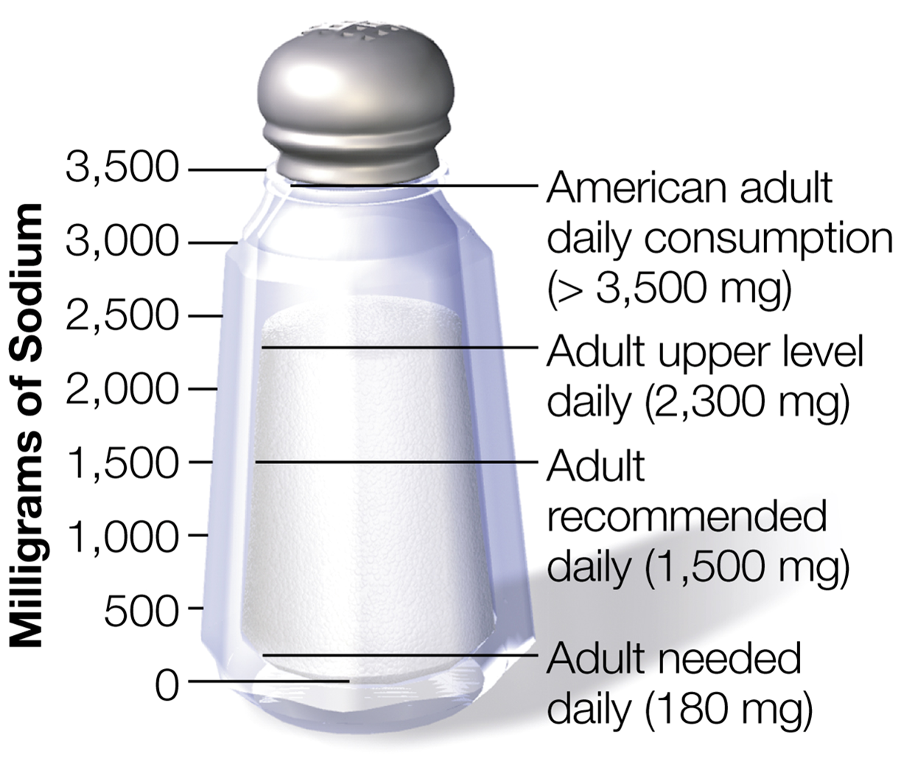
Figure 8.12 Recommended Intake of Sodium

Slide 37
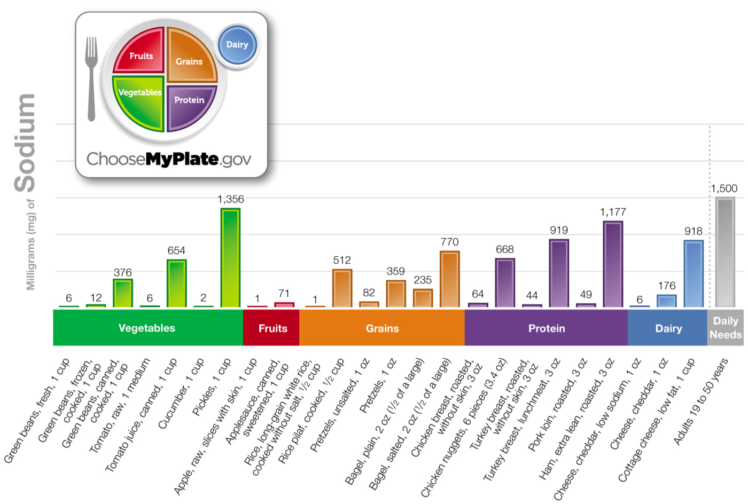
Figure 8.13 Sodium Content of Selected Natural and Processed Foods

Slide 38
Exploring Sodium (3 of 3)
Too much or too little:
  U L for adults is set at 2,300 milligrams/day to reduce the risk of hypertension (high blood pressure)
    Cut back on processed foods and salt added to foods to lower sodium intake
  Sodium deficiency is rare in healthy individuals consuming a balanced diet

Slide 39
You and Your Blood Pressure (1 of 2)
Blood pressure: a measure of force that blood exerts on the walls of arteries
Expressed as systolic pressure (when heart beats) over diastolic pressure (when heart is at rest between beats)
  <120/80 millimeters H g is normal
  Systolic >120 or diastolic >80 = prehypertension
  ≥140/90 = hypertension

Slide 40
You and Your Blood Pressure (2 of 2)
Hypertension is a silent killer
  No symptoms – have blood pressure checked regularly
  Contributes to atherosclerosis, heart enlarges and weakens
  Damages arteries leading to brain and kidneys, increasing risk of stroke and kidney disease
To control hypertension:
  Reduce weight, increase physical activity, eat a balanced diet

Slide 41
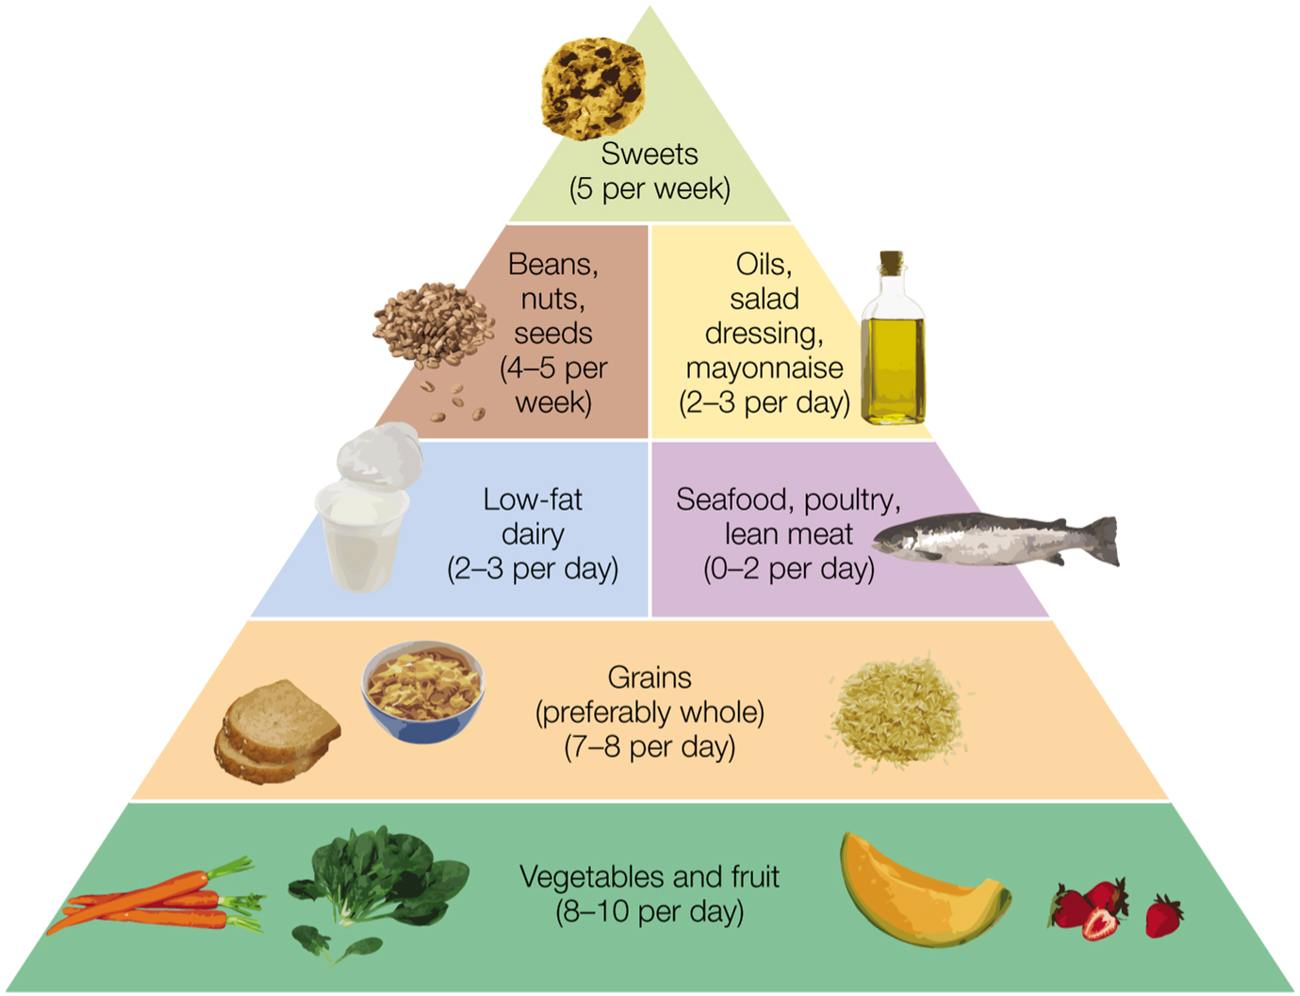
Figure 8.14 The D A S H: (Dietary Approaches to Stop Hypertension)

Slide 42
Table 8.4 Take Charge of Your Blood Pressure
If You | By | Your Systolic Blood Pressure* May Be Reduced by
Reduce your sodium intake | Keeping dietary sodium consumption to less than 2,400 milligrams daily | 8–14 millimeters H g
Lose excess weight | Modifying your diet and exercise to reach and maintain a normal, healthy body weight | 5–20 millimeters H g for every 22 pound s of weight loss
Stay physically active | Partaking in 30 minutes of aerobic activity (e.g., brisk walking) on most days of the week | 4–9 millimeters H g
Drink alcohol only in Moderation | Limiting consumption to no more than 2 drinks daily for men and 1 drink daily for women | 2–4 millimeters H g
Follow the DASH diet | Consuming this diet, which is abundant in fruits and vegetables and low-fat dairy products | 8–14 millimeters H g
* Controlling the systolic pressure is more difficult than controlling the diastolic pressure, especially for individuals 50 years of age and older. Therefore, it is the primary focus for lowering blood pressure. Typically, as systolic pressure goes down with diet and lifestyle changes, the diastolic pressure will follow.

Slide 43
Exploring Potassium (1 of 3)
Important mineral with many functions:
  Fluid balance: electrolyte inside cells
  A blood buffer: helps keep blood p H and acid-base balance correct
  Muscle contraction and nerve impulse conduction
  Can help lower high blood pressure
  Aids in bone health: helps increase bone density
  Reduces kidney stones by helping to excrete citrate (binds with calcium to form kidney stones)

Slide 44
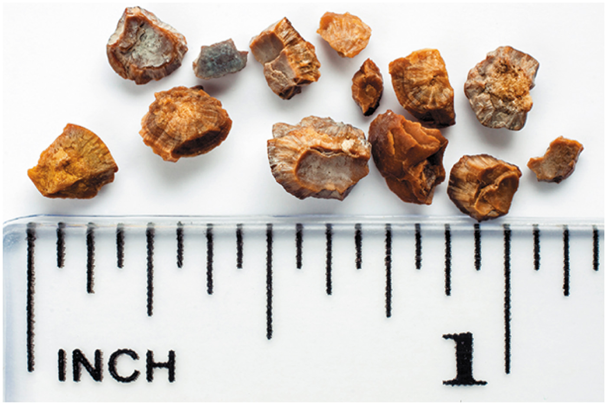
Figure 8.15 Kidney Stone

Slide 45
Exploring Potassium (2 of 3)
Daily needs:
  Adults: 4,700 milligrams/day
  Adult females consume only about 2,400 milligrams/day and adult males only 3,170 milligrams/day, on average
Food sources:
  Fruits and vegetables
    Minimum of 4½ cups/day will help meet potassium needs
  Dairy foods, nuts, legumes also good sources

Slide 46
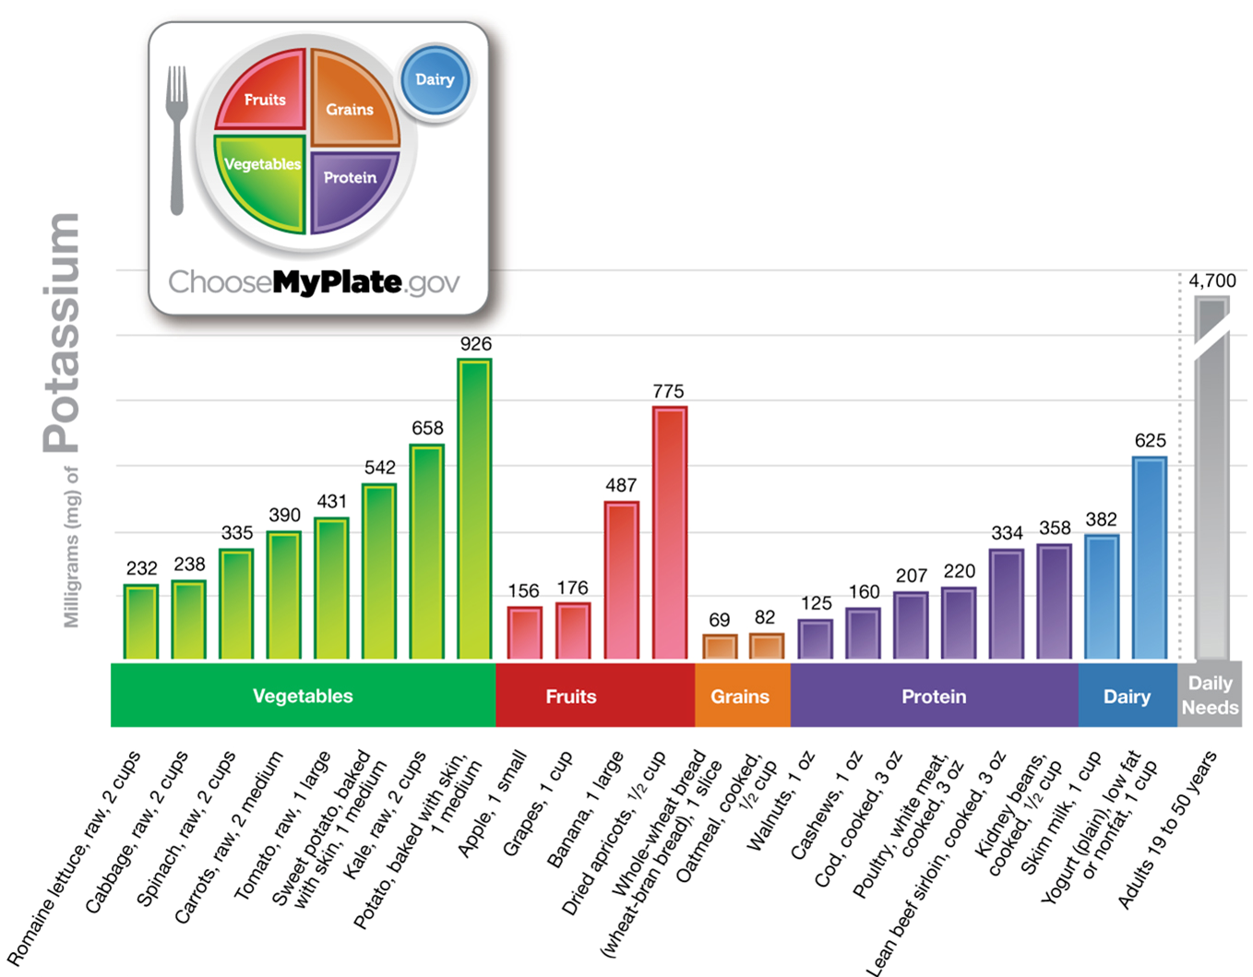
Figure 8.16 Potassium Content in Selected Foods

Slide 47
Exploring Potassium (3 of 3)
Too much or too little:
  Too much from supplements or salt substitutes can cause hyperkalemia in some individuals
    Can cause irregular heartbeats, damage heart, and be life-threatening
  Too little can cause hypokalemia
    Can cause muscle weakness, cramps, irregular heartbeats, and paralysis
    Can occur as result of excessive vomiting and/or diarrhea, anorexia and/or bulimia eating disorders

Slide 48
Exploring Calcium (1 of 3)
Most abundant mineral in body
  More than 99 percent located in bones and teeth
Functions:
  Helps build strong bones and teeth
  Plays a role in muscles, nerves, and blood
  May help lower high blood pressure
  May fight colon cancer
  May reduce risk of kidney stones (though supplements have opposite effect)

Slide 49
Exploring Calcium (2 of 3)
Daily needs:
  1,000 to 1,200 milligrams/day, depending on age
Food sources:
  Milk, yogurt, cheese, broccoli, kale, canned salmon (with bones), tofu processed with calcium, calcium-fortified juices and cereals

Slide 50
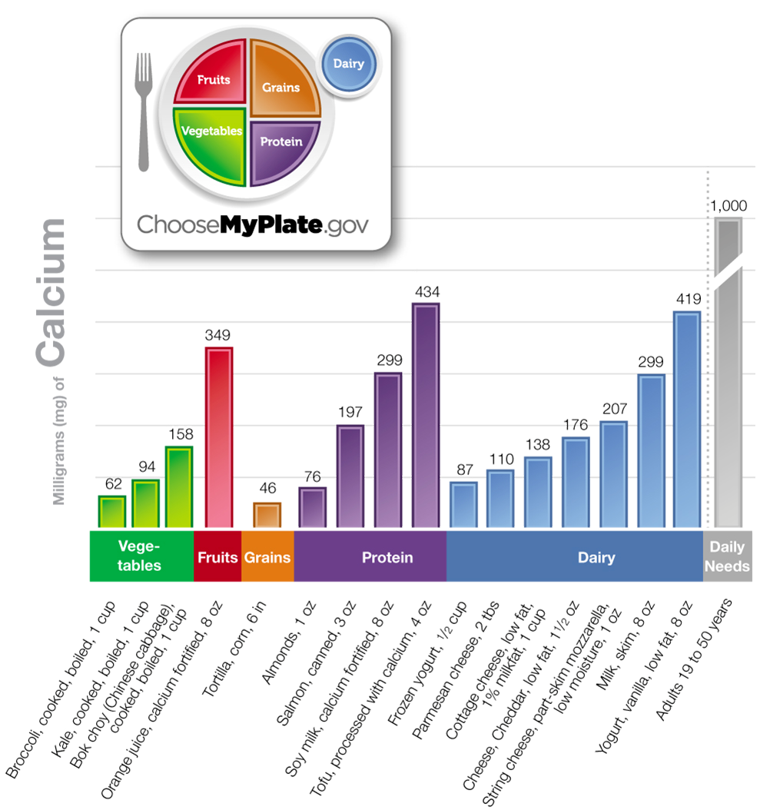
Figure 8.17 Calcium Content in Selected Foods

Slide 51
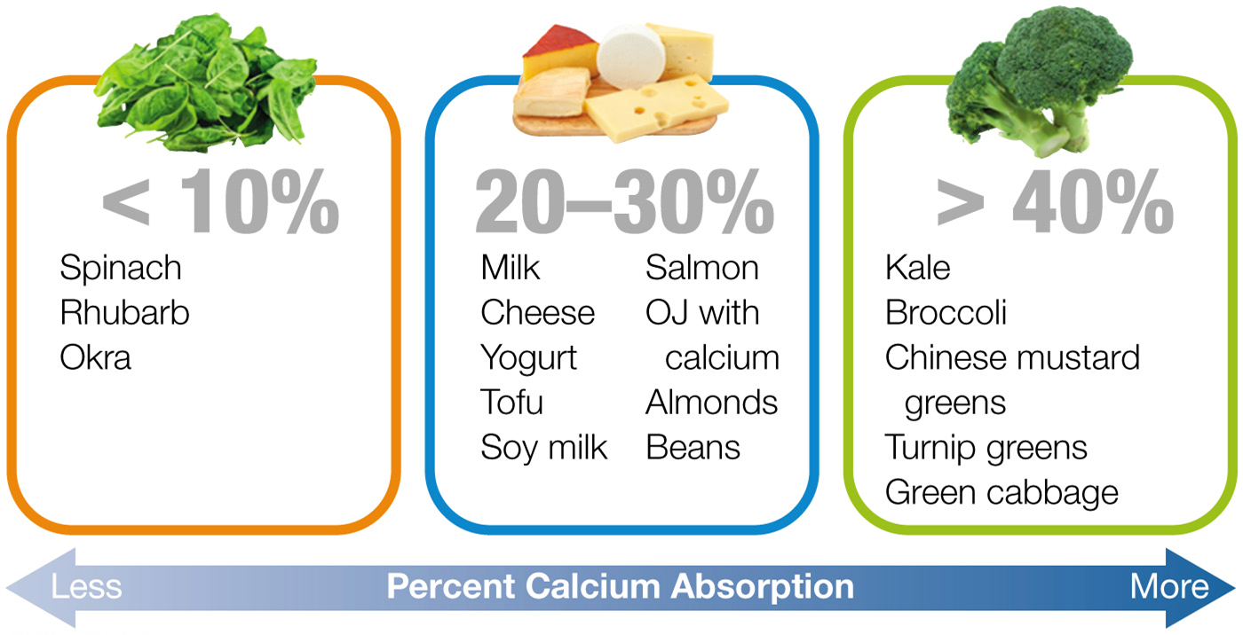
Figure 8.18 Bioavailability of Calcium

Slide 52
Exploring Calcium (3 of 3)
Too much or too little:
  U L: 2,500 milligrams/day (ages 19–50); 2,000 milligrams (51+)
  Too much calcium leads to hypercalcemia: impaired kidneys, calcium deposits in body
  Too little can lead to less dense, weakened, brittle bones, and increased risk for osteoporosis
Calcium supplements:
  Consume in doses of 500 milligrams or less
  Some sources (oyster shell, bone meal, dolomite) may contain lead, other toxic metals
  May be inadvisable if consuming enough in foods

Slide 53
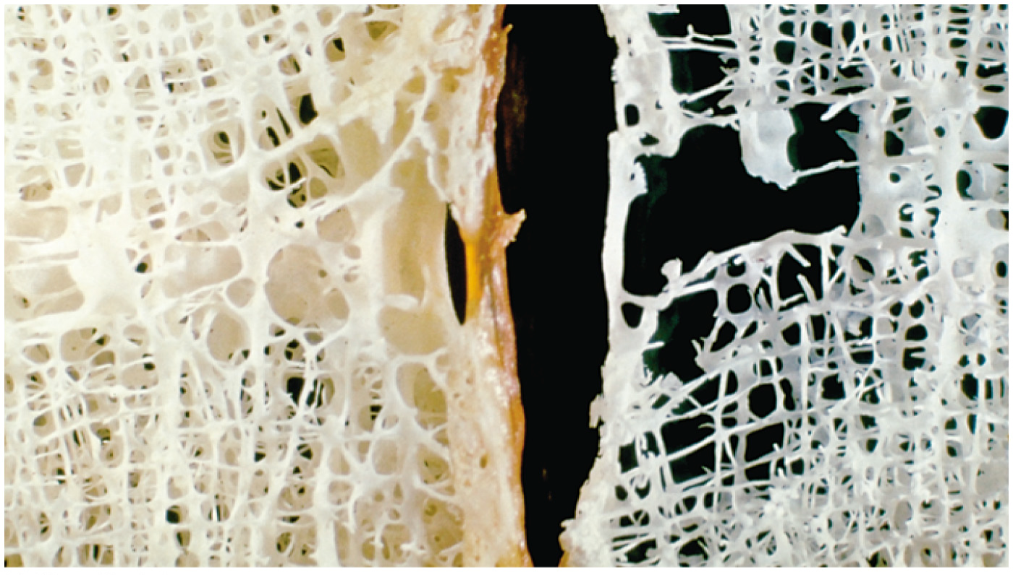
Figure 8.19 Healthy Bone (left) versus Weakened Bone (right)

Slide 54
Osteoporosis: Not Just Your Grandmother's Problem (1 of 3)
Bones are living tissue, constantly changing
Peak bone mass occurs in early adulthood (20s)
  Then slowly more bone is lost than added
  As bones lose mass, they become more porous and prone to fractures, leading to osteoporosis
Bone mineral density (B M D) test measures bone density
  Low score = osteopenia (low bone mass)
  Very low score = osteoporosis

Slide 55
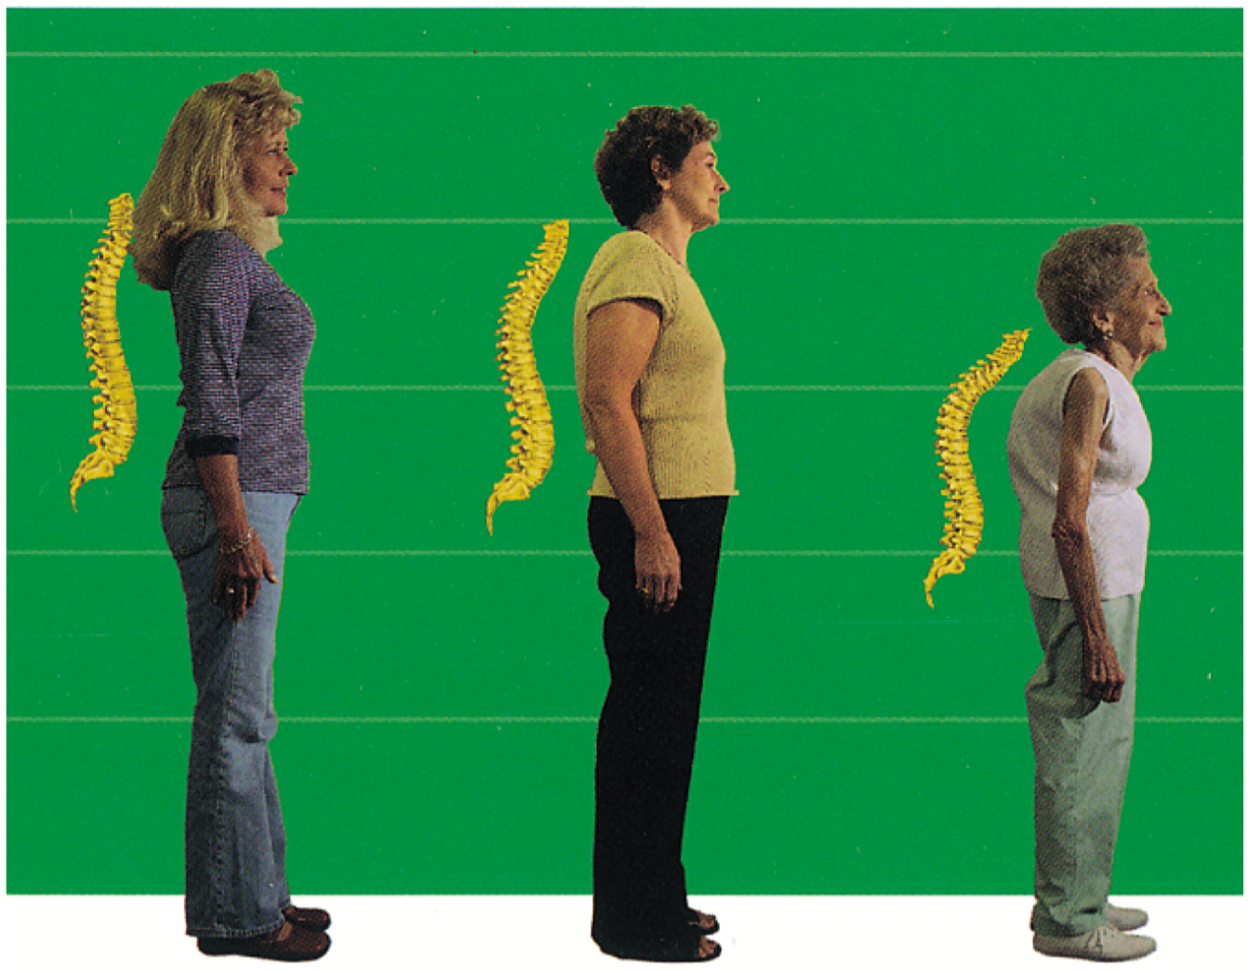
Figure 8.20 Weakened Bones Cause the Spine to Collapse over Time

Slide 56
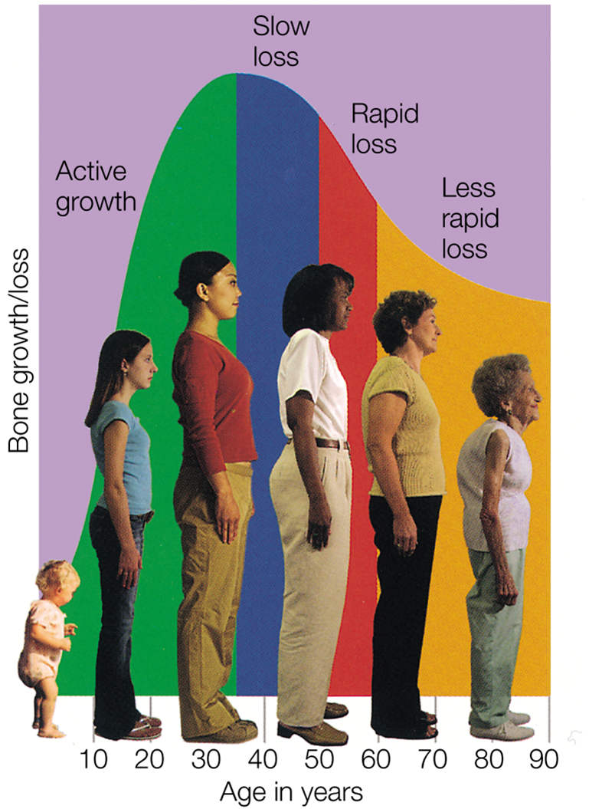
Figure 8.21 Change in Bone Mass Over Time

Slide 57
Osteoporosis: Not Just Your Grandmother's Problem (2 of 3)
Risk factors:
  Gender (females at higher risk due to loss of estrogen after menopause)
  Ethnicity (Caucasian and Asian-American at higher risk)
  Age (over 30)
  Body type (small-boned/petite women at higher risk)
  Family history of fractures increases risk
  Level of sex hormones (amenorrhea, menopause, or men with low levels of sex hormones)

Slide 58
Osteoporosis: Not Just Your Grandmother's Problem (3 of 3)
Risk factors (continued):
  Medications: glucocorticoids, antiseizure medications, aluminum-containing antacids, high amounts of thyroid replacement hormones
  Smoking
  Low physical activity: 30 minutes per day recommended
  Alcohol (more than one drink for women, two for men)
  Inadequate calcium and vitamin D (less than three cups/day of vitamin D-fortified milk or yogurt)

Slide 59
Exploring Phosphorus (1 of 2)
Second most abundant mineral in body
  85 percent in bones; rest in cells and fluids outside cells, including blood
Functions:
  Needed for bones and teeth
  Important component of cell membranes
  Needed for energy metabolism and stores
  Acts as a blood buffer
  Part of D N A and R N A

Slide 60
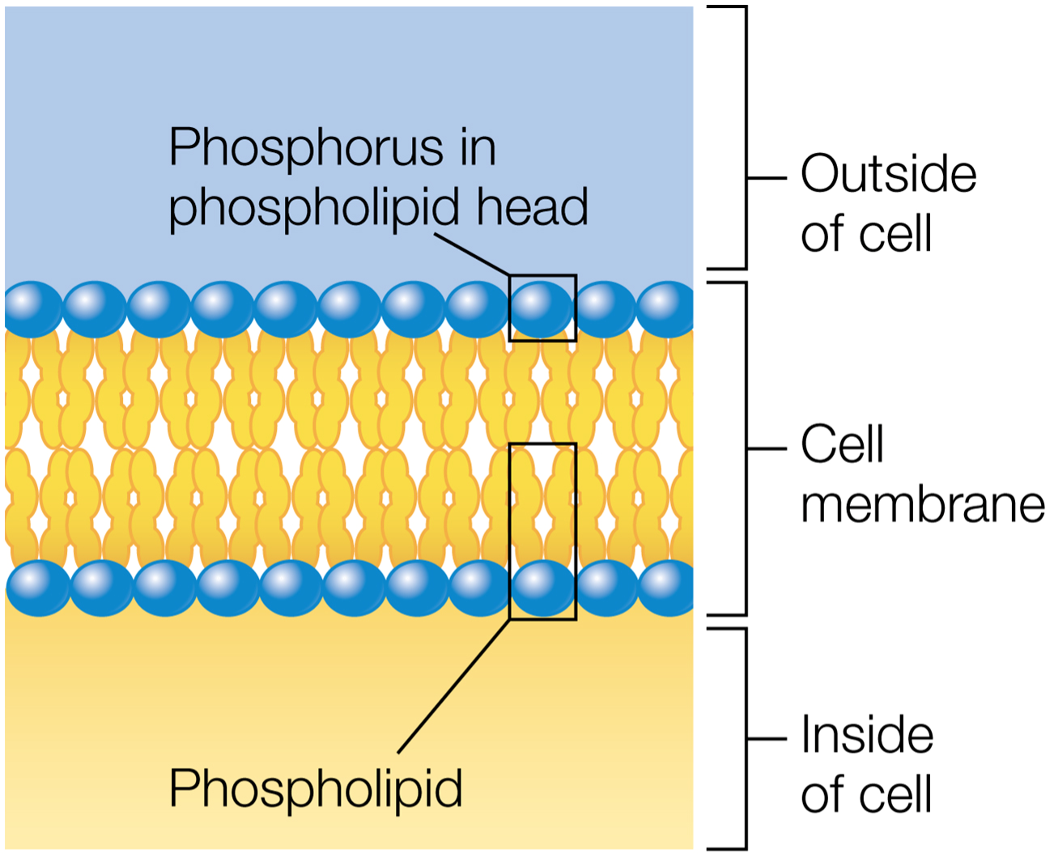
Figure 8.22 Phosphorus in Phospholipids

Slide 61
Exploring Phosphorus (2 of 2)
Daily needs:
  Adults: 700 milligrams/day
Food sources:
  Meat, fish, poultry, dairy
  Abundant in diet
Too much or too little:
  U L set at 4,000 milligrams/day for adults 19 to 50 to prevent hyperphosphatemia, which can lead to calcification of tissues; 3,000 milligrams for those aged 51 or older
  Too little can result in muscle weakness, bone pain, rickets, confusion, death; would need to be in state of near starvation to experience deficiency

Slide 62
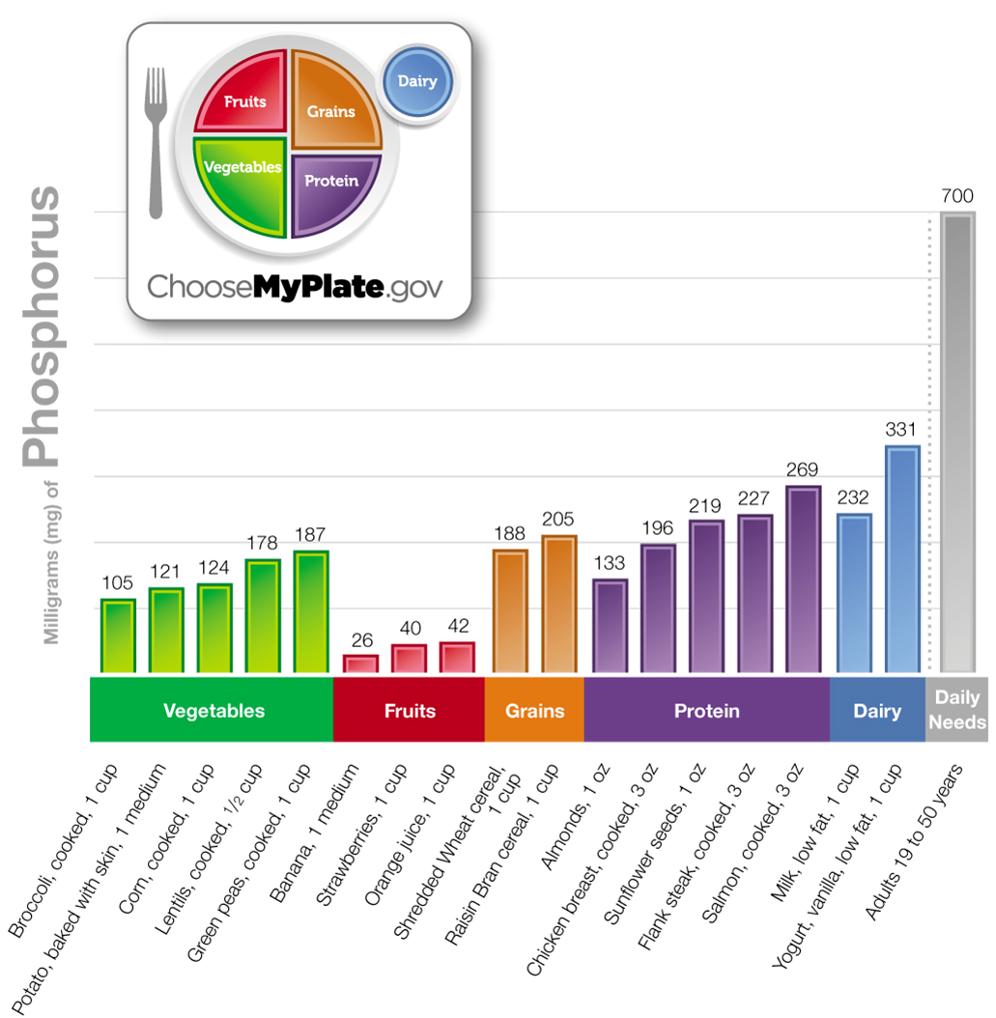
Figure 8.23 Phosphorus Content of Selected Foods

Slide 63
Exploring Magnesium (1 of 2)
Another abundant mineral in body
  About half in bones; most of rest inside cells
Functions:
  Helps more than 300 enzymes, including energy metabolism
  Used in synthesis of protein
  Helps muscles and nerves function properly
  Maintains healthy bones and regular heartbeat
  May help lower high blood pressure and reduce risk of type 2 diabetes

Slide 64
Exploring Magnesium (2 of 2)
Daily needs:
  19 to 30 years: males, 400 milligrams/day; females, 310 milligrams/day
  >30 years: males, 420 milligrams/day; females, 320 milligrams/day
  Many Americans fall short (80 to 85 percent of needs)
Food sources:
  Whole grains, vegetables, nuts, fruits; also milk, yogurt, meat, eggs
Too much or too little:
  U L from supplements (not foods) = 350 milligrams/day to avoid diarrhea
  Deficiencies are rare, but diuretics and some antibiotics can inhibit absorption

Slide 65
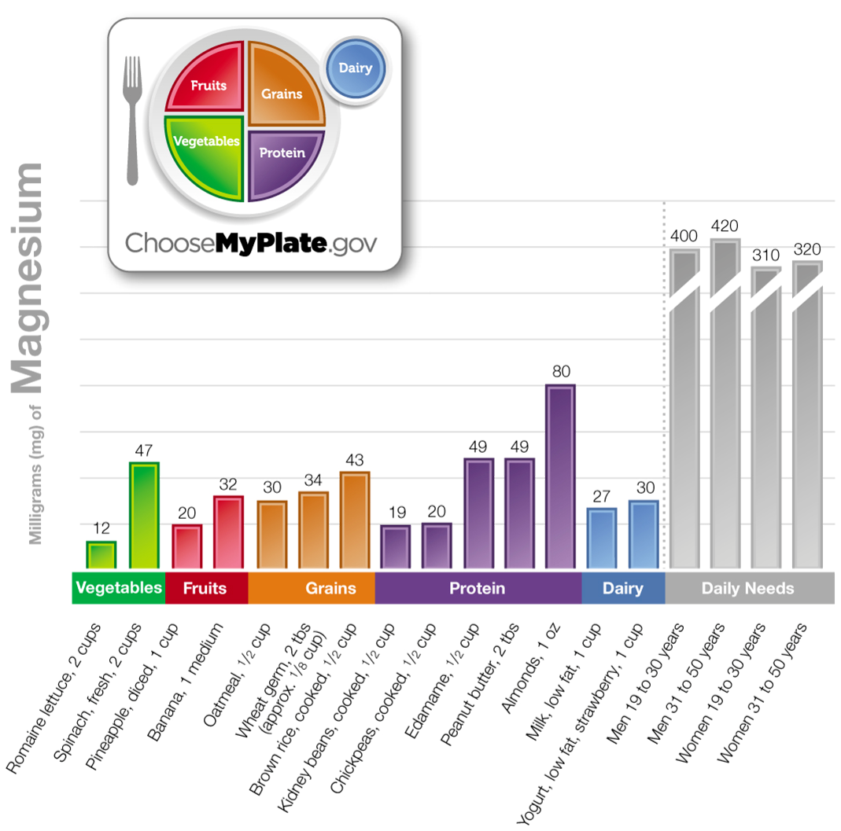
Figure 8.24 Magnesium Content of Selected Foods

Slide 66
Exploring Chloride
Chloride is part of hydrochloric acid in the stomach, which enhances protein digestion
Functions:
  Sodium and chloride are major electrolytes outside cells and in blood to help maintain fluid balance
  Acts as buffer to keep blood at normal p H
Daily needs: adults: 2,300 milligrams/day
Food sources: salt (N a C l) is main source
Too much or too little: deficiencies are rare
  U L 3,600 milligrams/day to match sodium U L

Slide 67
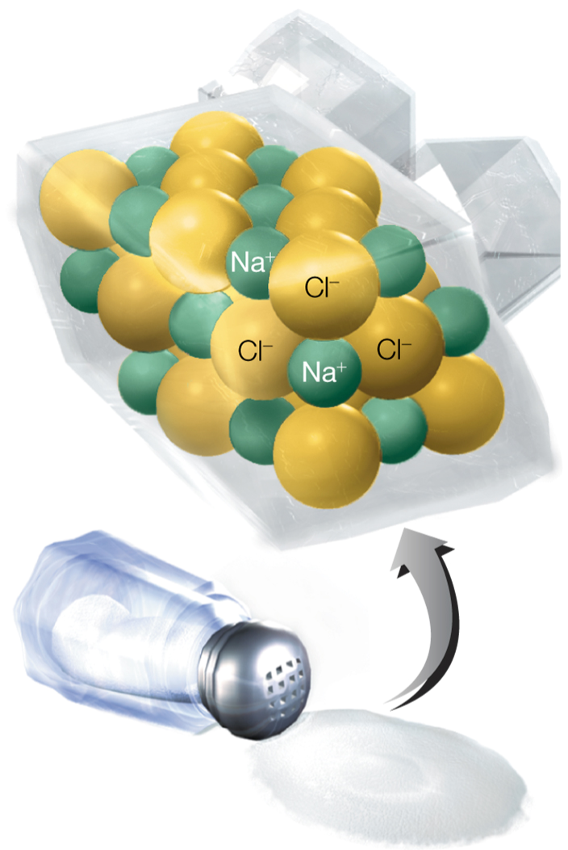
Figure 8.25 Table Salt Is Composed of Sodium and Chloride

Slide 68
Exploring Sulfur
Component of other compounds in body, including the vitamins thiamin, biotin, pantothenic acid
Functions:
  Helps give proteins 3-D shape as part of amino acids methionine, cystine, and cysteine
  Sulfites used as food preservative
Food sources: meat, poultry, fish, eggs, legumes, dairy, fruits, vegetables
Too much or too little: no known toxicity or deficiency symptoms

Slide 69
Exploring Iron (1 of 3)
Most abundant mineral on earth and main trace mineral in body
Two forms: heme and nonheme iron
  Heme iron from animal sources is part of hemoglobin and myoglobin and easily absorbed
  Nonheme iron in plant foods is not as easily absorbed, due to phytates and other substances
  Body absorbs only 10 to 15 percent of iron consumed
  Absorption increases if body stores are low
  Not excreted in urine or stool; once absorbed, very little leaves body (95 percent recycled, reused)

Slide 70
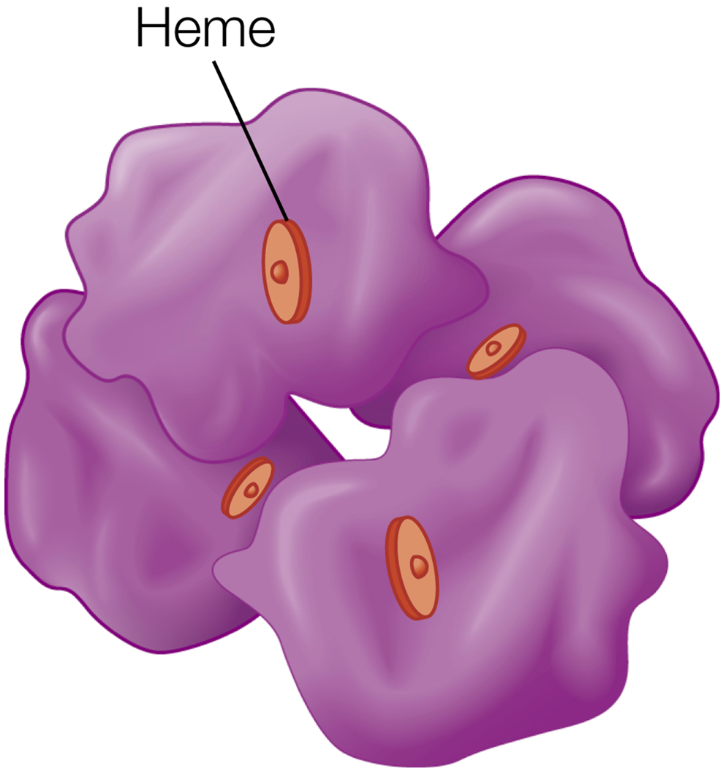
Figure 8.26 Hemoglobin Contains Heme Iron

Slide 71
Exploring Iron (2 of 3)
Functions:
  Hemoglobin in red blood cells transports oxygen from lungs to tissues and picks up carbon dioxide waste from cells
  Myoglobin transports and stores oxygen in muscle cells
  Aids brain function by helping enzymes that make neurotransmitters
Daily needs:
  Men and women >50: 8 milligrams/day
  Women 19 to 50: 18 milligrams/day: higher due to iron lost during menstruation
Food sources:
  Iron-enriched bread and grain products; heme iron in meats, fish, and poultry

Slide 72
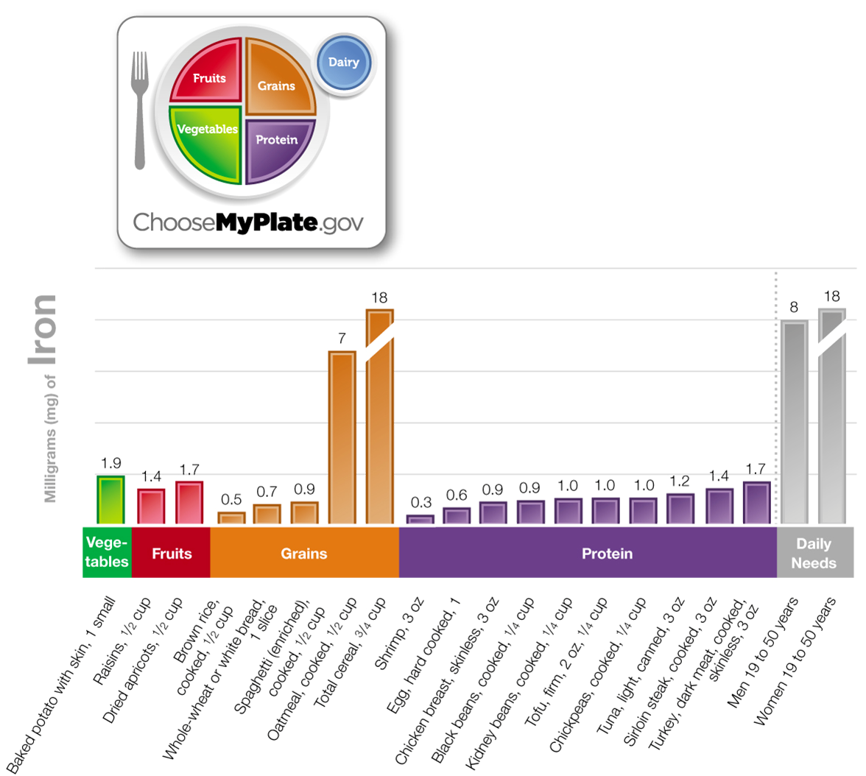
Figure 8.27 Iron Content of Selected Foods

Slide 73
Exploring Iron (3 of 3)
Too much or too little:
  Too much iron from supplements can cause constipation, nausea, vomiting, diarrhea
  In United States, a leading cause of accidental poisoning deaths in children under 6 years
  Iron overload can damage heart, kidneys, liver, nervous system
  Hemochromatosis, a genetic disorder, can cause iron overload
  Iron deficiency: most common nutritional disorder in world
  Iron-deficiency anemia occurs when iron stores are depleted and hemoglobin levels decrease

Slide 74
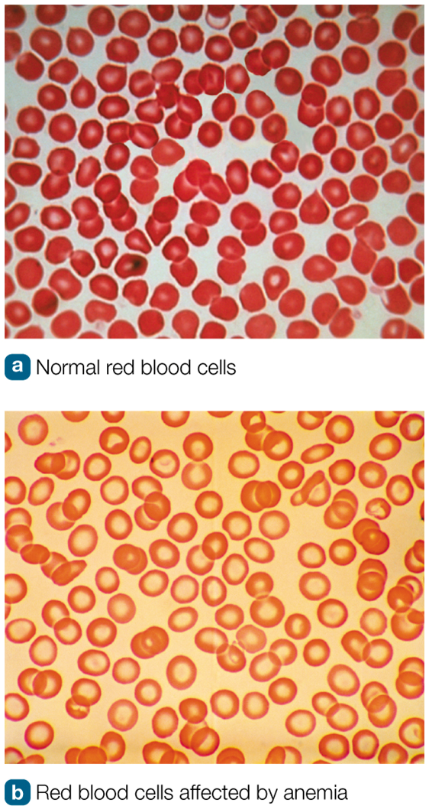
Figure 8.28 Normal and Anemic Blood Cells

Slide 75
Exploring Copper (1 of 2)
Functions:
  Part of many enzymes and proteins
  Important for iron absorption and transfer, synthesis of hemoglobin and red blood cells
  Helps generate energy in cells, synthesize melanin, link the proteins collagen and elastin together in connective tissues
  Helps enzymes protect cells from free radicals
  Role in blood clotting and maintaining healthy immune system

Slide 76
Exploring Copper (2 of 2)
Daily needs:
  Adults: 900 µ g/day
Food sources:
  Organ meats, seafood, nuts, seeds, bran cereals, whole-grain products, cocoa
Too much or too little:
  U L: 10,000 µ g/day
  Excess can cause stomach cramps, nausea, diarrhea, vomiting, liver damage
  Copper deficiency rare in United States

Slide 77
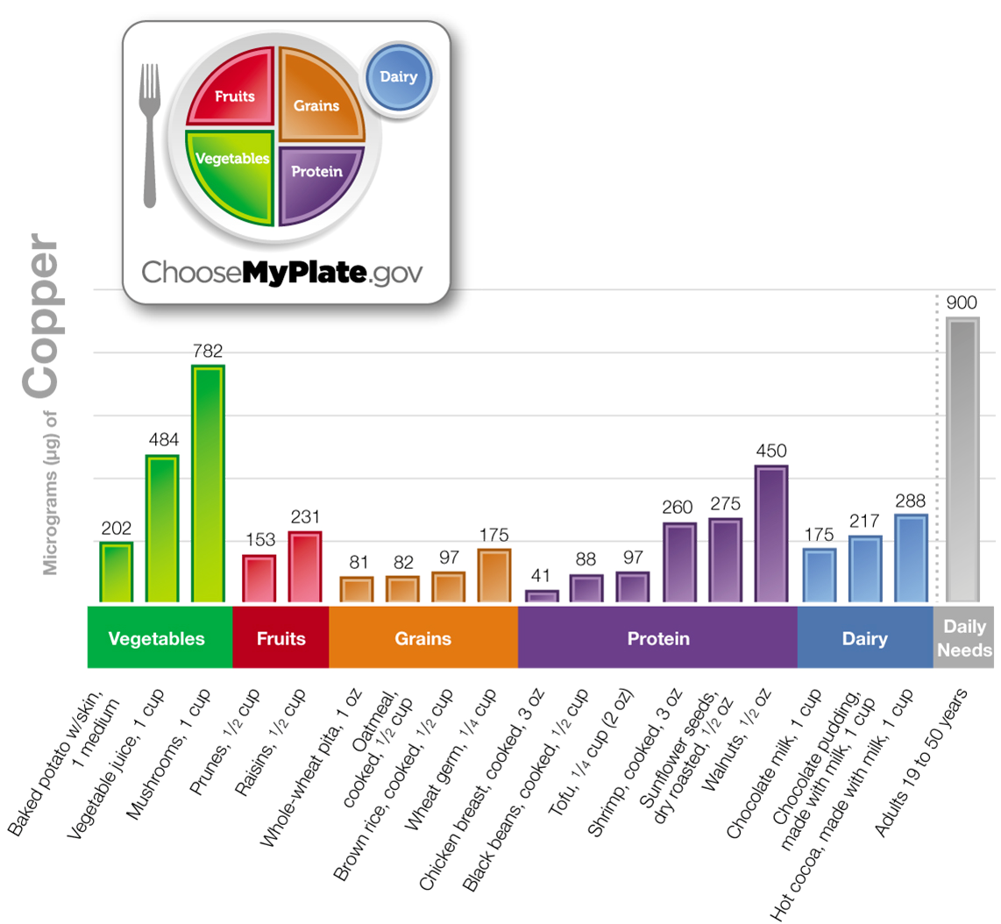
Figure 8.29 Copper Content of Selected Foods

Slide 78
Exploring Zinc (1 of 2)
Involved in function of more than 100 enzymes
Functions:
  D N A synthesis, growth, and development
  Healthy immune system and wound healing
  Taste acuity
  Treatment for common cold
  May reduce risk of age-related macular degeneration
Daily needs:
  Men: 11 milligrams/day; women: 8 milligrams/day
  Vegetarians may need as much as 50 percent more

Slide 79
Exploring Zinc (2 of 2)
Food sources:
  Red meat, some seafood, whole grains
Too much or too little:
  U L = 40 milligrams/day
  As little as 50 milligrams can cause stomach pains, nausea, vomiting, diarrhea
  60 milligrams/day can inhibit copper absorption
  Excessive amounts can suppress immune system, lower H D L cholesterol
  Deficiency: hair loss, impaired taste, loss of appetite, diarrhea, delayed sexual maturation, impotence, skin rashes, impaired growth

Slide 80
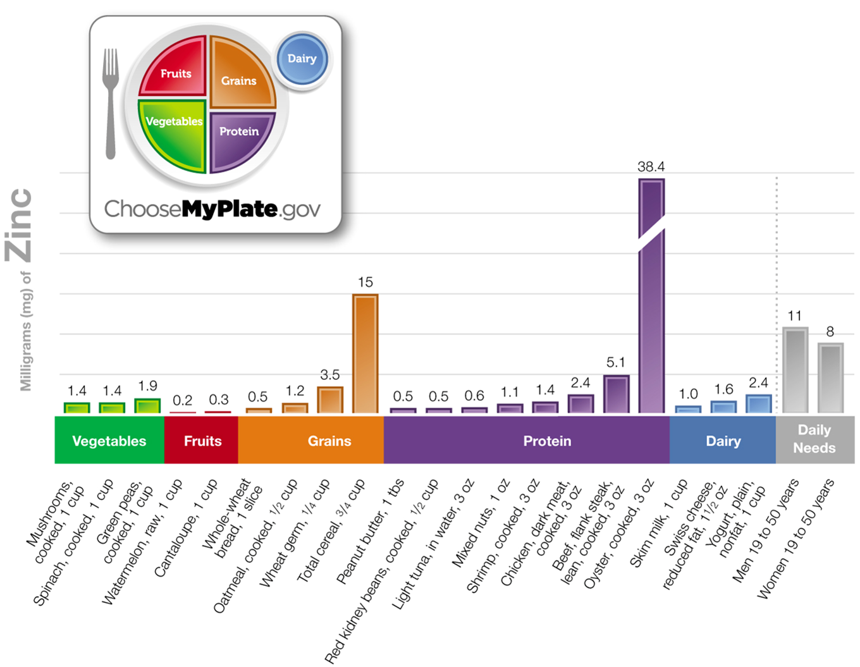
Figure 8.30 Zinc Content of Selected Foods

Slide 81
Exploring Selenium (1 of 2)
Part of class of proteins called selenoproteins, many of which are enzymes
Functions of selenoproteins:
  Help regulate thyroid hormones
  Act as antioxidants
  May help fight cancer
Daily needs: adults: 55 µ g/day
Food sources: meat, seafood, cereal, grains, dairy foods, fruits, vegetables
  Amount varies depending on soil content

Slide 82
Exploring Selenium (2 of 2)
Too much or too little:
  U L = 400 µ g/day
  Too much can cause toxic condition selenosis
    Symptoms: brittleness and loss of nails and hair, stomach and intestinal discomfort, skin rash, garlicky breath, fatigue, nervous system damage
  Selenium deficiency is rare in United States
    Deficiency can cause Keshan disease (heart damage): seen in children in rural areas that have selenium-poor soils

Slide 83
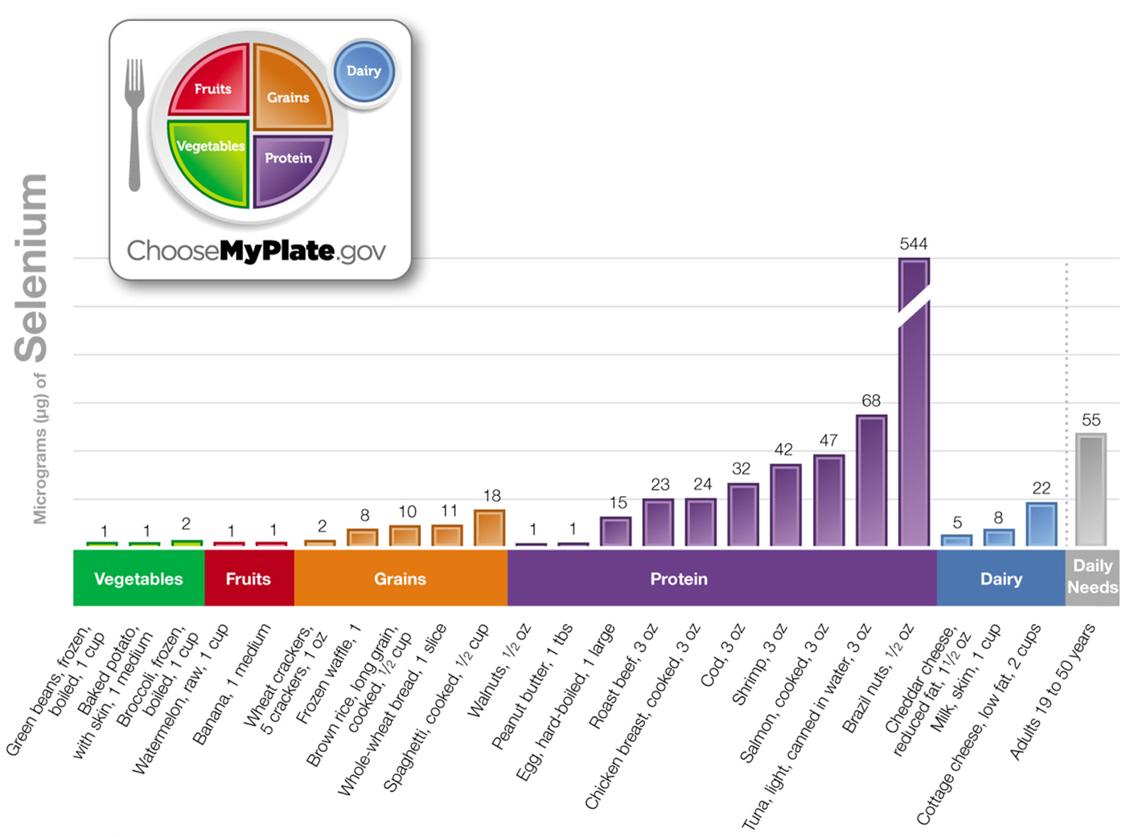
Figure 8.31 Selenium Content in Selected Foods

Slide 84
Exploring Fluoride (1 of 1)
Functions:
  Protects against dental caries
    Helps repair enamel eroded by acids from bacteria
    Reduces amount of acid bacteria produce
    Provides protective barrier
  Fluoridated drinking water has reduced dental caries in United States
Daily needs:
  Men: 3.8 milligrams/day; women: 3.1 milligrams/day

Slide 85
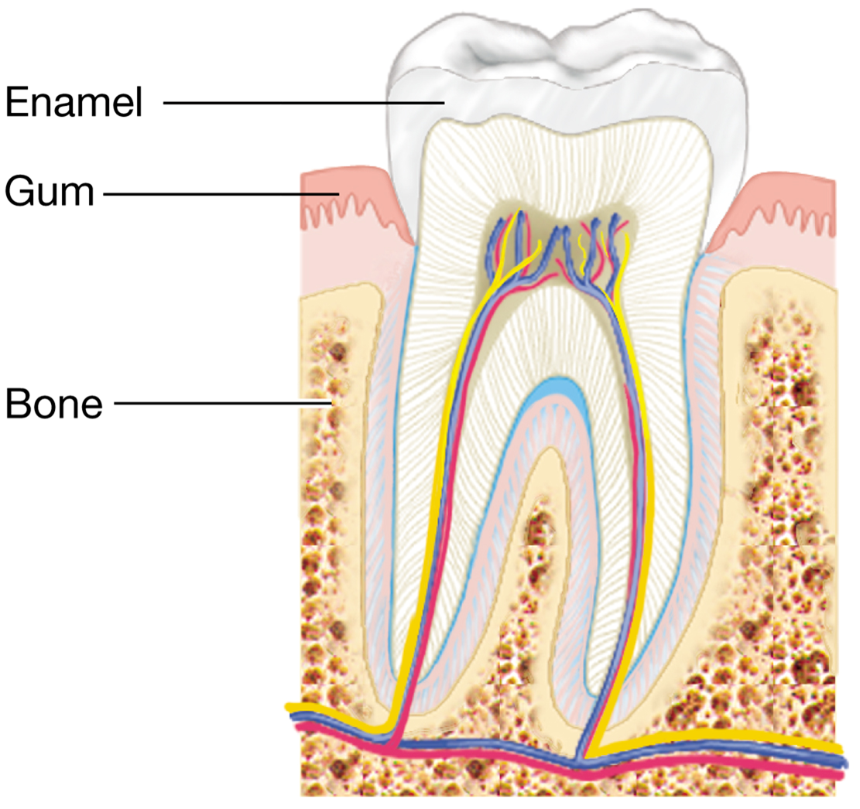
Figure 8.32 Structure of a Tooth

Slide 86
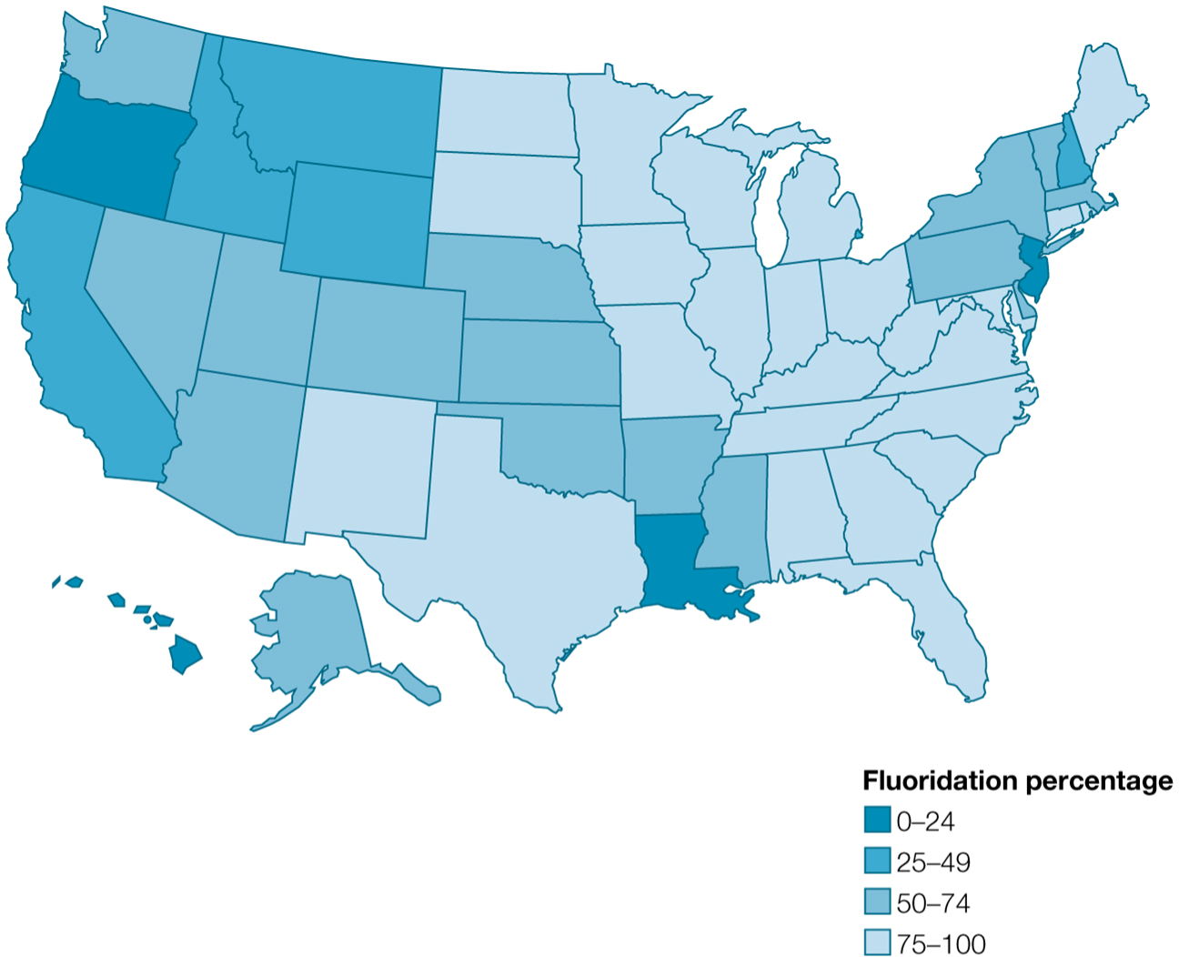
Figure 8.33 Percentage of Americans Living in Communities with Fluoridated Water Supply, by State, 2012

Slide 87
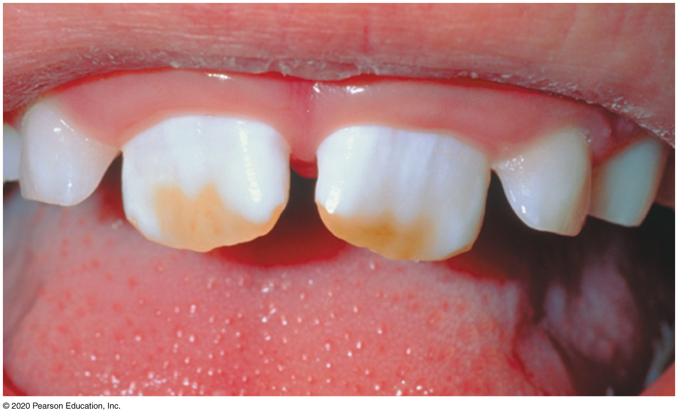
Exploring Fluoride (2 of 2)
Sources: foods are not a good source
  Best source is fluoridated drinking water and beverages made with this water
Too much or too little:
  Too little increases risk of dental caries.
  Too much can cause fluorosis (mottling/staining) when teeth are forming during infancy/childhood.
    Fluorosis of bones can occur when >10 milligrams/day is consumed for 10 or more years.
  U L: adults:10 milligrams/day, much lower for infants and children

Slide 88
Exploring Chromium (1 of 2)
Functions:
  Helps insulin in your body
    Increases effectiveness in cells
May improve blood glucose control, but no large study confirms this theory
    Small study suggests chromium supplement may reduce risk of insulin resistance
    F D A allows a Qualified Health Claim on chromium supplements, but label must state that evidence is not certain
  Does not help build muscle mass

Slide 89
Exploring Chromium (2 of 2)
Daily needs: men: 30 to 35 µg; women: 20 to 25 µ g
Food sources: grains, meat, fish, poultry, some fruits and vegetables
Too much or too little:
  No known risk from consuming too much
  Deficiency is rare in United States

Slide 90
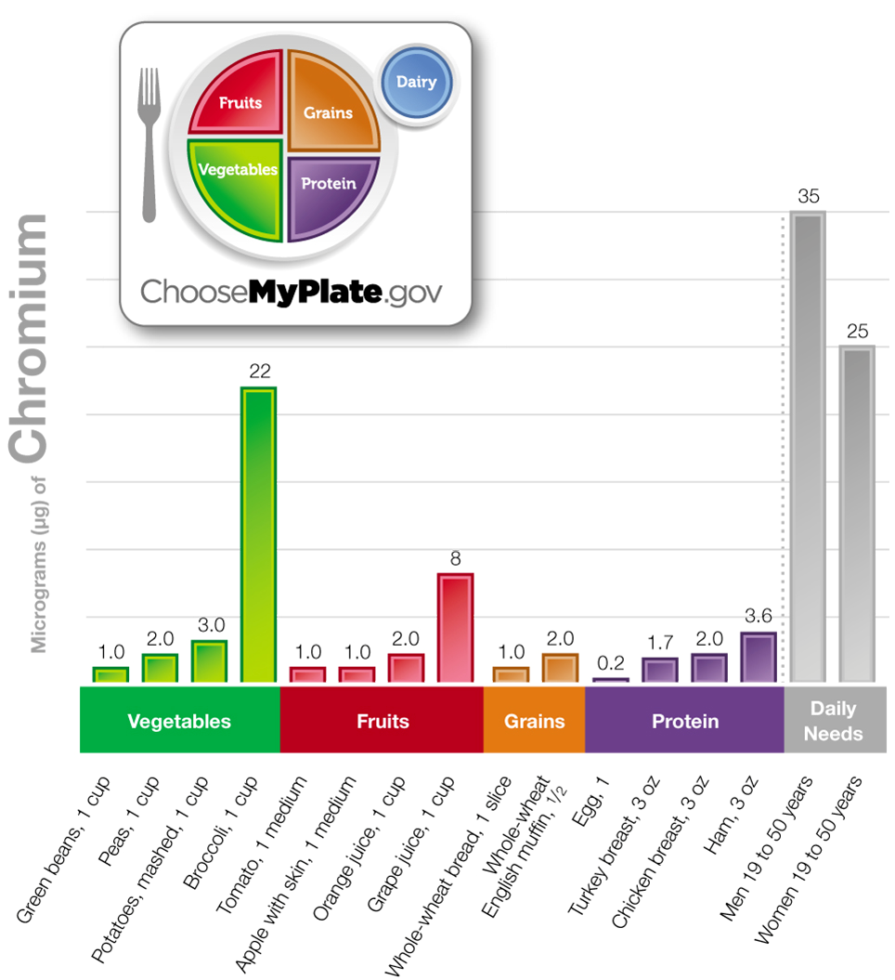
Figure 8.34 Chromium Content in Selected Foods

Slide 91
Exploring Iodine (1 of 2)
Functions: needed by thyroid to make essential hormones
  Thyroid hormones regulate metabolic rate; help heart, nerves, muscle and intestines function properly
Daily needs: adults: 150 µ g/day
Food sources: iodized salt (400 µ g/teaspoon)
  Amount in foods is low; depends on iodine content of soil, water, fertilizer
  Salt-water fish have higher amounts

Slide 92

Figure 8.35 Location of Thyroid Gland

Slide 93
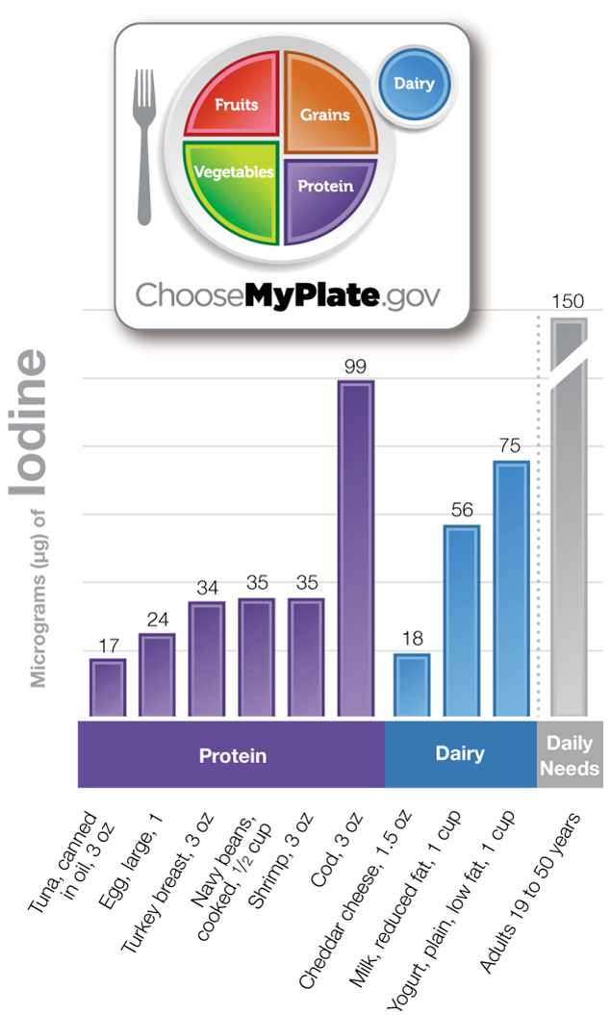
Figure 8.36 Iodine Content in Selected Foods

Slide 94
Exploring Iodine (2 of 2)
Too much or too little: U L = 1,100 µ g/day
    Excess iodine can impair thyroid function, decrease synthesis and release of thyroid hormones
  Early sign of deficiency = goiter (enlarged thyroid gland)
    Mandatory iodization of salt has decreased iodine deficiency in United States but not in other parts of world
    Iodine deficiency during early stages of fetal development can cause cretinism (congenital hypothyroidism)

Slide 95

Goiter

Slide 96
Exploring Manganese
Part of, or activates, many enzymes in body
Functions:
  Helps metabolize carbohydrates, fats, amino acids
  Aids bone formation
Daily needs: men: 2.3 milligrams/day; women: 1.8 milligrams/day
Food sources: whole grains, nuts, legumes, tea, vegetables, pineapples, strawberries, bananas
Too much or too little:
  U L = 11 milligrams/day to avoid toxicity with Parkinson's disease-like symptoms

Slide 97
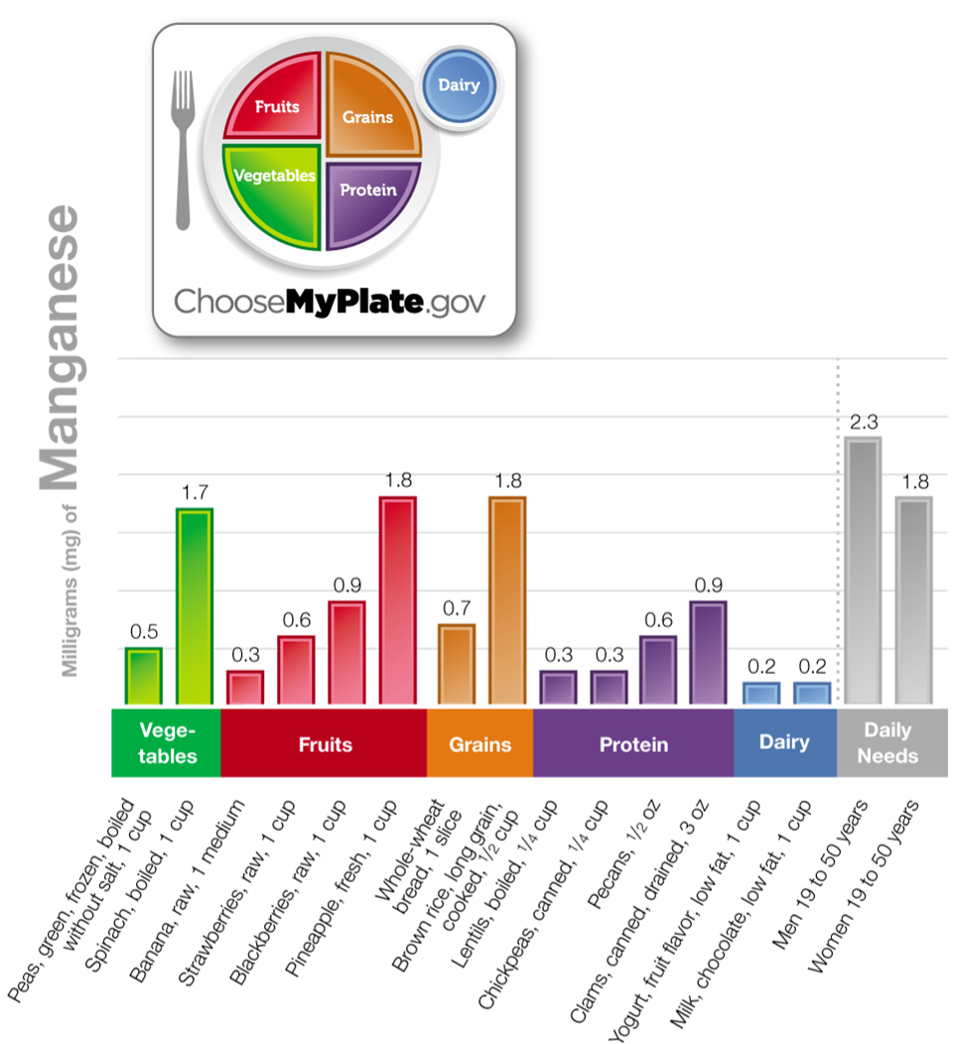
Figure 8.37 Manganese Content of Selected Foods

Slide 98
Exploring Molybdenum
Functions: part of several enzymes involved in breakdown of certain amino acids and other compounds
Daily needs: adults: 45 µ g/day
Food sources: legumes, grains, nuts
Too much or too little:
  U L = 2 µ g/day, based on animal studies in which too much molybdenum caused reproductive problems
  No cases seen in healthy individuals

Slide 99
Other Minerals
Arsenic, boron, nickel, silicon, and vanadium
  Exist in body but essential role in humans not established by research
  May have function for some animals
  Tolerable upper levels set for:
    Boron: 20 milligrams/day (10 times more than average American consumes)
    Nickel: 1 milligram/day
    Vanadium: 1.8 milligrams/day

Slide 100
Table 8.1 Minerals at a Glance: Major Minerals (1 of 2)
Major Minerals | Major Functions | Adult D R I, 19 to 50 years | Food Sources | Excessive/ Toxicity Symptoms/U L | Deficiency Symptoms/ Conditions
Sodium | Major electrolyte outside the cell; helps regulate body water and blood pressure | 1,500 milligrams/day | Processed foods, table salt, meat, seafood, milk, cheese, eggs | Hypertension U L: 2,300 milligrams/day | Rare in individuals consuming a healthy diet
Potassium | Major mineral inside the cell, needed for muscle contraction and nerve impulses; regulates body water and blood pressure | 4,700 milligrams/day | Potatoes, melons, citrus fruits, most fruits and vegetables, meat, milk, legumes | Hyperkalemia | Hypokalemia
Calcium | Formation of bones and teeth, muscle contraction and relaxation, blood clotting, heart and nerve function | 1,000 milligrams/day | Milk and dairy products, leafy greens, broccoli, salmon, sardines, tofu | Hypercalcemia U L: 2,500 milligrams/day | Osteoporosis

Slide 101
Table 8.1 Minerals at a Glance: Major Minerals (2 of 2)
Major Minerals | Major Functions | Adult D R I, 19 to 50 years | Food Sources | Excessive/ Toxicity Symptoms/U L | Deficiency Symptoms/ Conditions
Phosphorus | Formation of bones and teeth | 700 milligrams/day | Meat, fish, poultry, eggs, dairy, cereals | Hyperphosphatemia U L: 4,000 milligrams/day | Muscle weakness, bone pain, rickets, confusion, and death
Magnesium | Participates in muscle contraction and nerve conduction | 310 to 420 milligrams/day | Meat, seafood, nuts, legumes, dairy, whole grains | Large intakes from supplements can cause diarrhea, cramps, and nausea | Rare
Chloride | Helps maintain fluid and acid-base balance | 2,300 milligrams/day | Found as sodium chloride in foods | U L: 3,600 milligrams/day | Rare
Sulfur | A part of other compounds in body; helps give some amino acids their three- dimensional shape | None | Meats, fish, poultry, eggs, dairy foods, fruits, vegetables | None | None

Slide 102
Table 8.2 Minerals at a Glance: Trace Minerals (1 of 3)
Trace Minerals | Major Functions | Adult DRI, 19 to 50 years | Food Sources | Excessive/ Toxicity Symptoms/U L | Deficiency Symptoms/ Conditions
Iron | As a major component of hemoglobin and myoglobin, helps transport oxygen throughout the body; enhances brain function | 8 to 18 milligrams/day | Meat, fish, poultry, enriched and fortified breads and cereals | Vomiting, nausea, diarrhea, constipation, organ damage including the kidney and liver U L: 45 milligrams/day | Fatigue, iron-deficiency anemia, growth retardation in infants
Copper | A component of several enzymes; involved in iron transport; needed for healthy connective tissue enzymes; role in blood clotting and a healthy immune system | 900 μ g/day | Organ meats, nuts, seeds, cocoa, whole grains, legumes, and shellfish | Vomiting, abdominal pain, nausea, diarrhea, liver damage U L: 10,000 μg/day | Impaired growth and development

Slide 103
Table 8.2 Minerals at a Glance: Trace Minerals (2 of 3)
Trace Minerals | Major Functions | Adult DRI, 19 to 50 years | Food Sources | Excessive/ Toxicity Symptoms/U L | Deficiency Symptoms/ Conditions
Zinc | Cofactor for several enzymes; D N A and R N A synthesis; needed for a healthy immune system, wound healing, and taste acuity | 8 to 11 milligrams/day | Meat, poultry, seafood, whole grains | Nausea, vomiting, cramps, diarrhea, impaired immune function U L: 40 milligrams/day | Skin rash and hair loss, diarrhea, loss of taste and smell
Selenium | A component of enzymes; antioxidant | 55 μ g/day | Meat, seafood, fish, eggs, whole grains | Selenosis, brittle hair and nails, skin rash, garlic breath odor, fatigue U L: 400 μg/day | Keshan disease
Fluoride | Makes teeth stronger | 3 to 4 milligrams/day | Fluoridated water, tea | Fluorosis in teeth and skeletal fluorosis U L: 10 milligrams/day | Increased susceptibility to dental caries

Slide 104
Table 8.2 Minerals at a Glance: Trace Minerals (3 of 3)
Trace Minerals | Major Functions | Adult DRI, 19 to 50 years | Food Sources | Excessive/ Toxicity Symptoms/U L | Deficiency Symptoms/ Conditions
Chromium | Improves insulin response | 20 to 35 μ g/day | Pork, egg yolks, whole grains, nuts | Unconfirmed toxicity effects | Potential increase of insulin resistance
Iodine | Component of a thyroid hormone | 150 μ g/day | Iodized salt, seafood, dairy products | Impaired functioning of thyroid U L: 1,100 μ g/day | Goiter, congenital hypothyroidism
Manganese | Cofactor involved in metabolism | 1.8 to 2.3 milligrams/day | Beans, oats, nuts, tea | Abnormal central nervous system effects U L: 11 milligrams/day | Deficiency rare; rash and scaly skin
Molybdenum | Cofactor for a variety of enzymes | 45 μ g/day | Legumes, nuts, leafy vegetables, dairy, cereals | Unknown in humans U L: 2 milligrams/day | Unknown in humans

Slide 105
Table 8.3 Additional Minerals (1 of 2)
Mineral | Potential Role and Deficiency Symptoms | Food Sources | Potential Toxicity
Arsenic | May be needed in the metabolism of a specific amino acid in rats. A deficiency may impair growth and reproduction in animals. | Dairy products, meat, poultry, fish, grains, and cereal products | No known adverse effect in humans from the organic form of arsenic found in foods. The inorganic form is poisonous to humans.
Boron | A deficiency may be associated with reproductive abnormalities in certain fish and frogs, which suggests a possible role in normal development in animals. | Grape juice, legumes, potatoes, pecans, peanut butter, apples, and milk | No known adverse effect from boron in food. Some research suggests that high amounts of boron may cause reproductive and developmental problems in animals. Because of this, the upper limit for human adults has been set at 20 milligrams daily, which is more than 10 times the amount American adults consume daily, on average.

Slide 106
Table 8.3 Additional Minerals (2 of 2)
Mineral | Potential Role and Deficiency Symptoms | Food Sources | Potential Toxicity
Nickel | May be needed by specific enzymes in the body. It is considered an essential mineral in animals. | Grains and grain products, vegetables, legumes, nuts, and chocolate | No known toxicity of nickel in humans when consuming a normal diet. In rats, high exposure to nickel salts can cause toxicity, with symptoms such as lethargy, irregular breathing, and lower than normal weight gain. Because of this, the upper limit for adults is set at 1 milligrams daily for nickel salts.
Silicon | May be needed for bone formation in animals. | Grains, grain products, and vegetables | No known risk of silicon toxicity in humans from food sources.
Vanadium | In animals, vanadium has insulin-like actions and a deficiency increases the risk of abortion. | Mushrooms, shellfish, parsley, and black pepper | No known risk of toxicity in humans from vanadium in foods. Too much has been shown to cause kidney damage in animals. Vanadium can be purchased as supplements. Because of the known toxicity in animals, the upper limit for adults is set at 1.8 milligrams daily.

Slide 107

Copyright
This work is protected by United States copyright laws and is provided solely for the use of instructors in teaching their courses and assessing student learning. Dissemination or sale of any part of this work (including on the World Wide Web) will destroy the integrity of the work and is not permitted. The work and materials from it should never be made available to students except by instructors using the accompanying text in their classes. All recipients of this work are expected to abide by these restrictions and to honor the intended pedagogical purposes and the needs of other instructors who rely on these materials.

